Slide 1


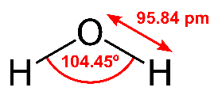
Water!
T. Pradeep
Institute Professor, IIT Madras
pradeep@iitm.ac.in
https://pradeepresearch.org
Since 1959
Why do we conserve? 1.386 billion km³
(~1.4 × 10¹⁸ tons)
$4.31x10¹⁴
Co-founder
InnoNano Research Pvt. Ltd. 001
InnoDI Water Technologies Pvt. Ltd.
VayuJAL Technologies Pvt. Ltd.
Aqueasy Innovations Pvt. Ltd.
Hydromaterials Pvt. Ltd.
EyeNetAqua Solutions Pvt. Ltd.
DeepSpectrum Innovations Pvt. Ltd.
Professor-in-charge
International Centre for Clean Water
Jigyasa Vigyan Mahotsav Bootcamp 1 on Water conservation, February 14, 2022

Slide 2
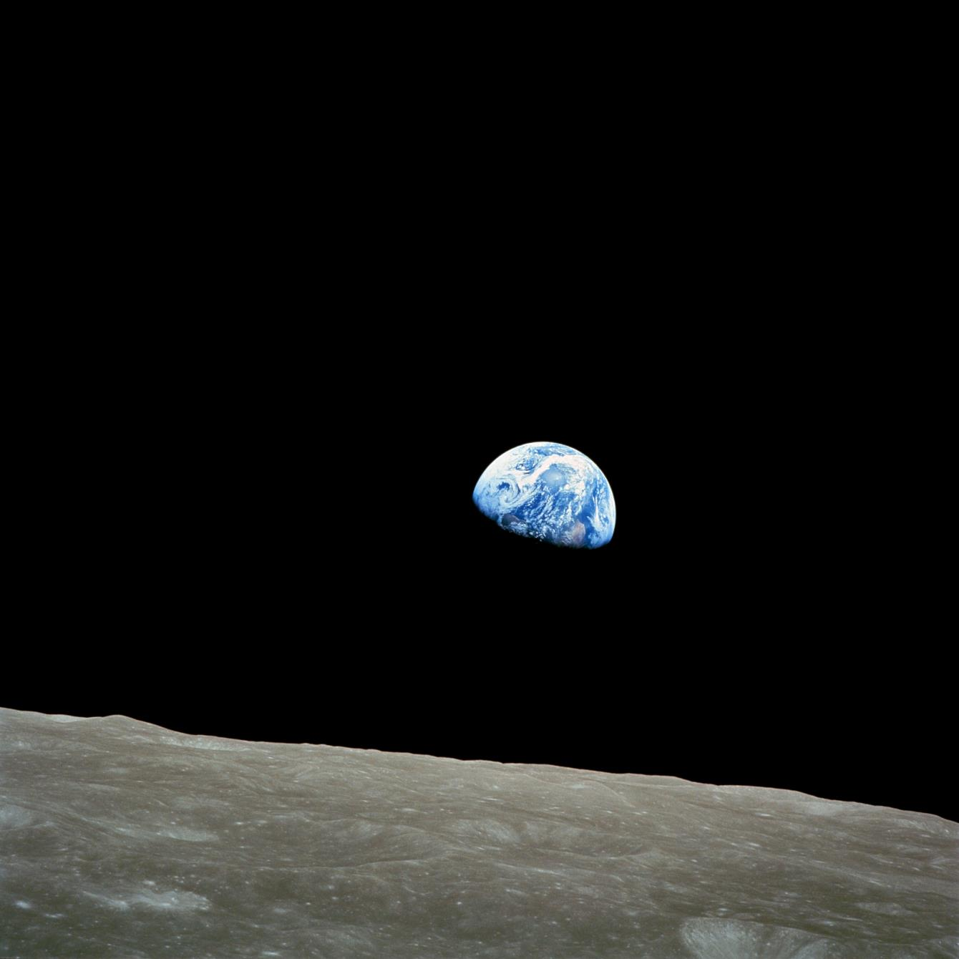
Earthrise, taken on December 24, 1968, by Apollo 8 astronaut William Andres.
Nature photographer Galen Rowell declared it "the most influential environmental photograph ever taken".

Slide 3
Water is the most important inheritance of our planet
“Pale blue dot” Voyager 1 Feb. 14, 1990

Slide 4
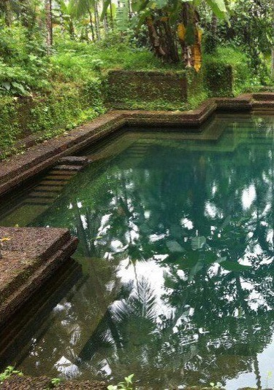
The truth
Our economic, social and cultural outcomes can be traced to water.
Water is the simplest and simultaneously the most complex problem of humanity.
Everything simplifies to water.
There is water in everything we do.

Slide 5
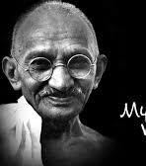
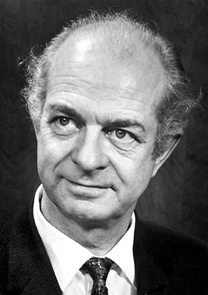
The earth, the air, the land and the water are not an inheritance from our forefathers but on loan from our children. So, we have to handover to them at least as it was handed over to us.
M. K. Gandhi
Life is a relationship among molecules and not a property of any molecule.
Linus Pauling

Slide 6
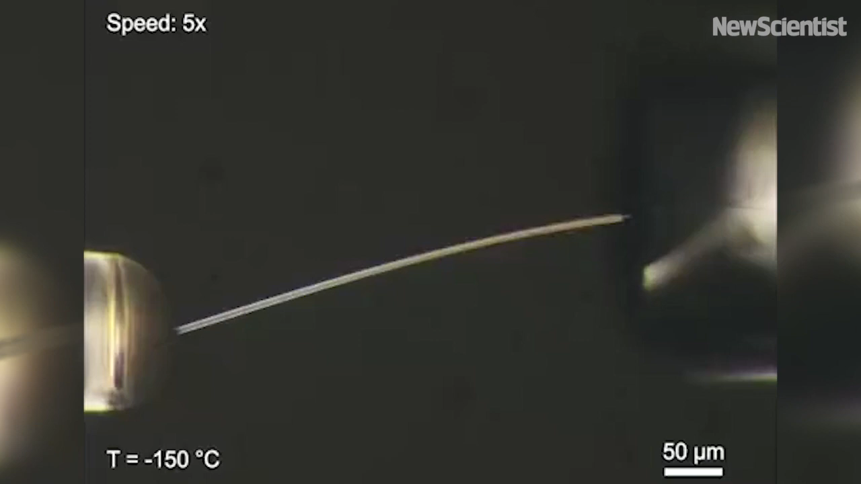
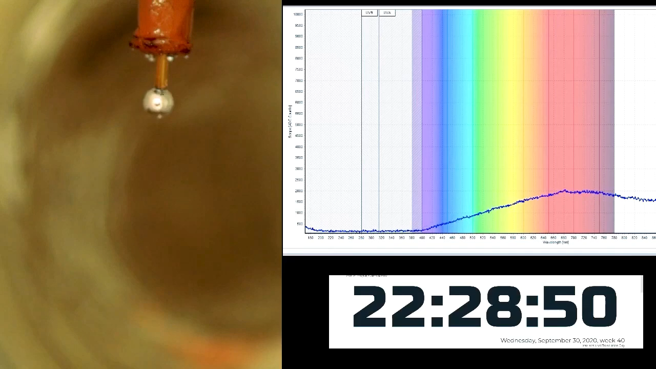
Water continues to fascinate science
Elastic ice
Metallic water
Xu, P. et al., Science, 2021, 373, 187–192
Mason, P. E. et al., Nature, 2021, 595, 673–676

Slide 7
Groundwater depletion
Total districts 742
Water stressed >300
256 with critical or overexploited ground water levels
‘India is suffering from its worst water crisis in its history.’
Data from NASA

Slide 8
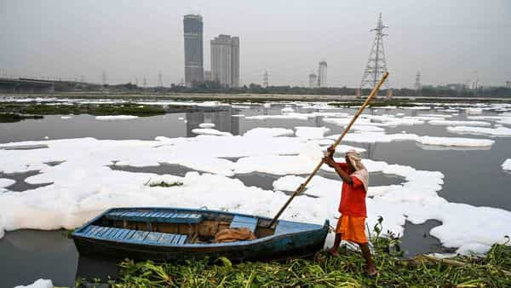
No river is free of pollution
https://www.livemint.com/news/india/delhi-cpcb-raises-concerns-on-pollution-in-yamuna-river-11607261448670.html
Dec. 6, 2020

Slide 9
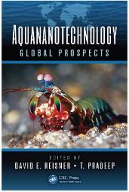
Affordable clean water is a problem of advanced materials
New adsorbents
New sensors
New catalysts
Novel phenomena
New devices

Slide 10
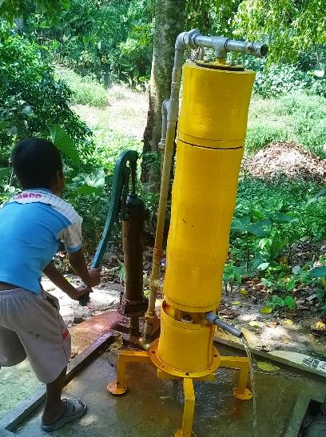
Nanomaterials can solve real problems
ACS Sustainable Chemistry & Engineering Editorial, December 2016

