Slide 1






Since 1959
Research ethics and intellectual property rights
T. Pradeep
Institute Professor, IIT Madras
pradeep@iitm.ac.in
Co-founder
InnoNano Research Pvt. Ltd.
InnoDI Water Technologies Pvt. Ltd.
VayuJAL Technologies Pvt. Ltd.
Aqueasy Innovations Pvt. Ltd.
Hydromaterials Pvt. Ltd.
EyeNetAqua Pvt. Ltd.
Deepspectrum Analytics Pvt. Ltd.
Dr. Renuka Rajarathnam and colleagues at Stella Maris College
Professor-in-charge
Associate Editor
International Centre for Clean Water
Stella Maris College, May 4, 2022

Slide 2
Ethics in Research Research Integrity Responsible Conduct of Research All mean the same. Do research well.

Slide 3
Back to basics
A system of accepted beliefs that control behaviour, especially such a system based on morals. (Cambridge)
Ethics are moral beliefs and rules about right and wrong. (Collins)
Ethics or moral philosophy seeks to resolve questions of human morality by defining concepts such as good and evil, right and wrong, virtue and vice, justice and crime.
The English word ethics is derived from the Ancient Greek word ēthikós (ἠθικός), meaning "relating to one's character", which itself comes from the root word êthos (ἦθος) meaning "character, moral nature". This word was transferred into Latin as ethica and then into French as éthique, from which it was transferred into English. (Wikipedia)
Animal ethics, bioethics, business ethics, machine ethics, military ethics, political ethics, public sector ethics, publication ethics, ethics of nanotechnology, ethics of quantification, ethics of technology,…
Ethics in research, ethics in publications, ethics in intellectual property,…

Slide 4
There are larger questions …
Science and morality
Why science?
Why do I do science?
Science and society
Conflicts – personal/financial/institutional

Slide 5
Science is about truth
To whom it belongs?
To everyone, as public funds research
Researchers
Colleagues and collaborators
Funding bodies
Research institutions/universities
Science is about being responsible

Slide 6
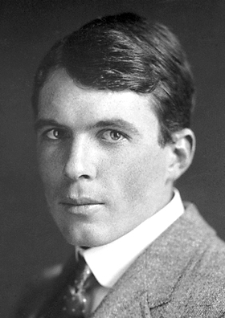
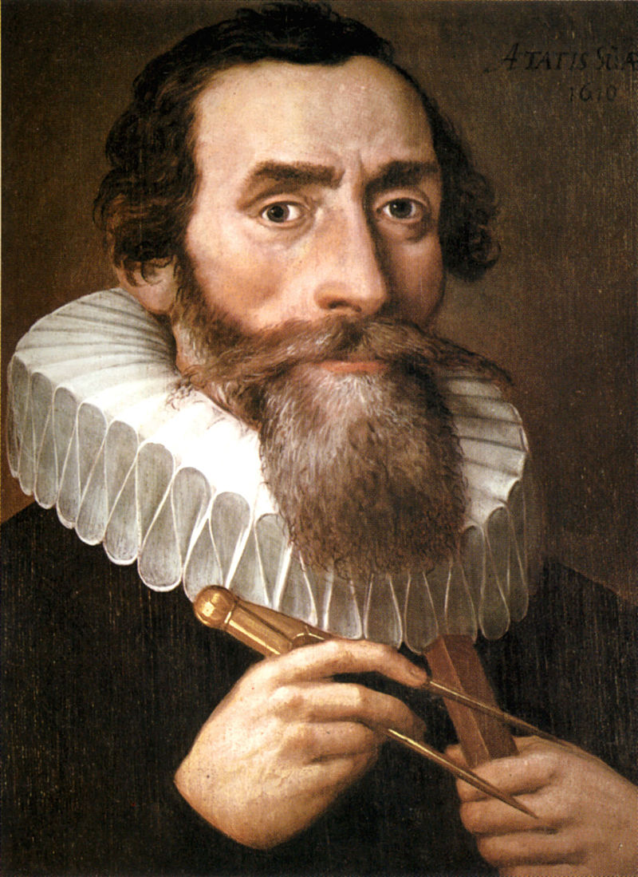
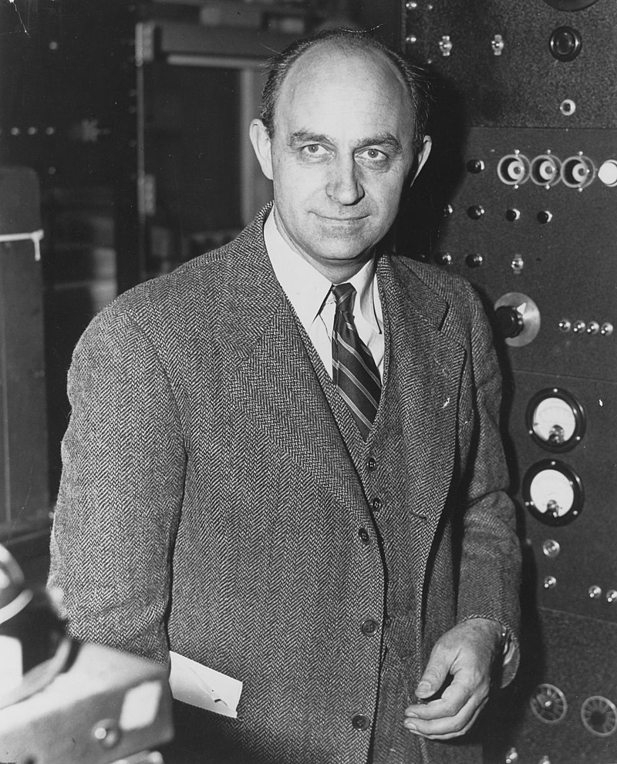
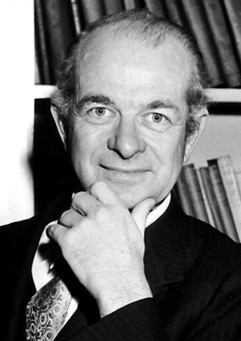
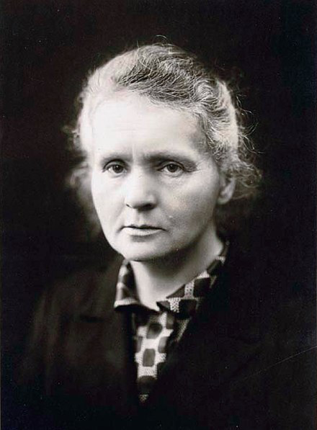
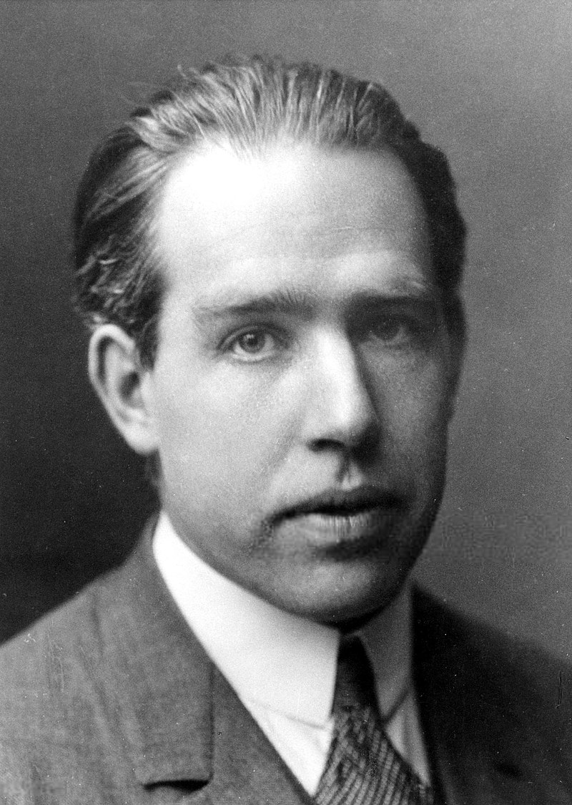
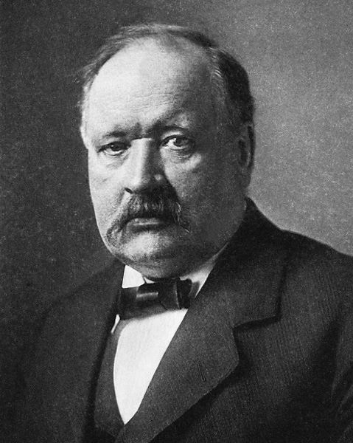
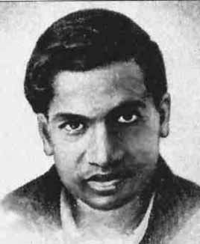
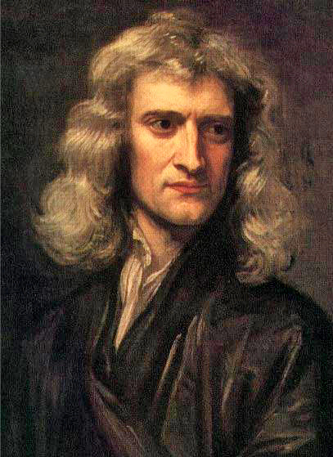
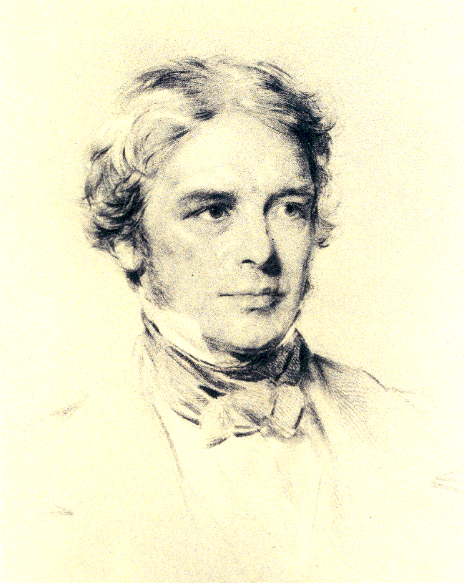
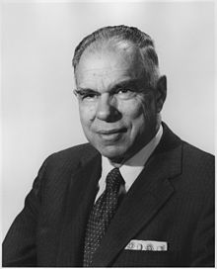
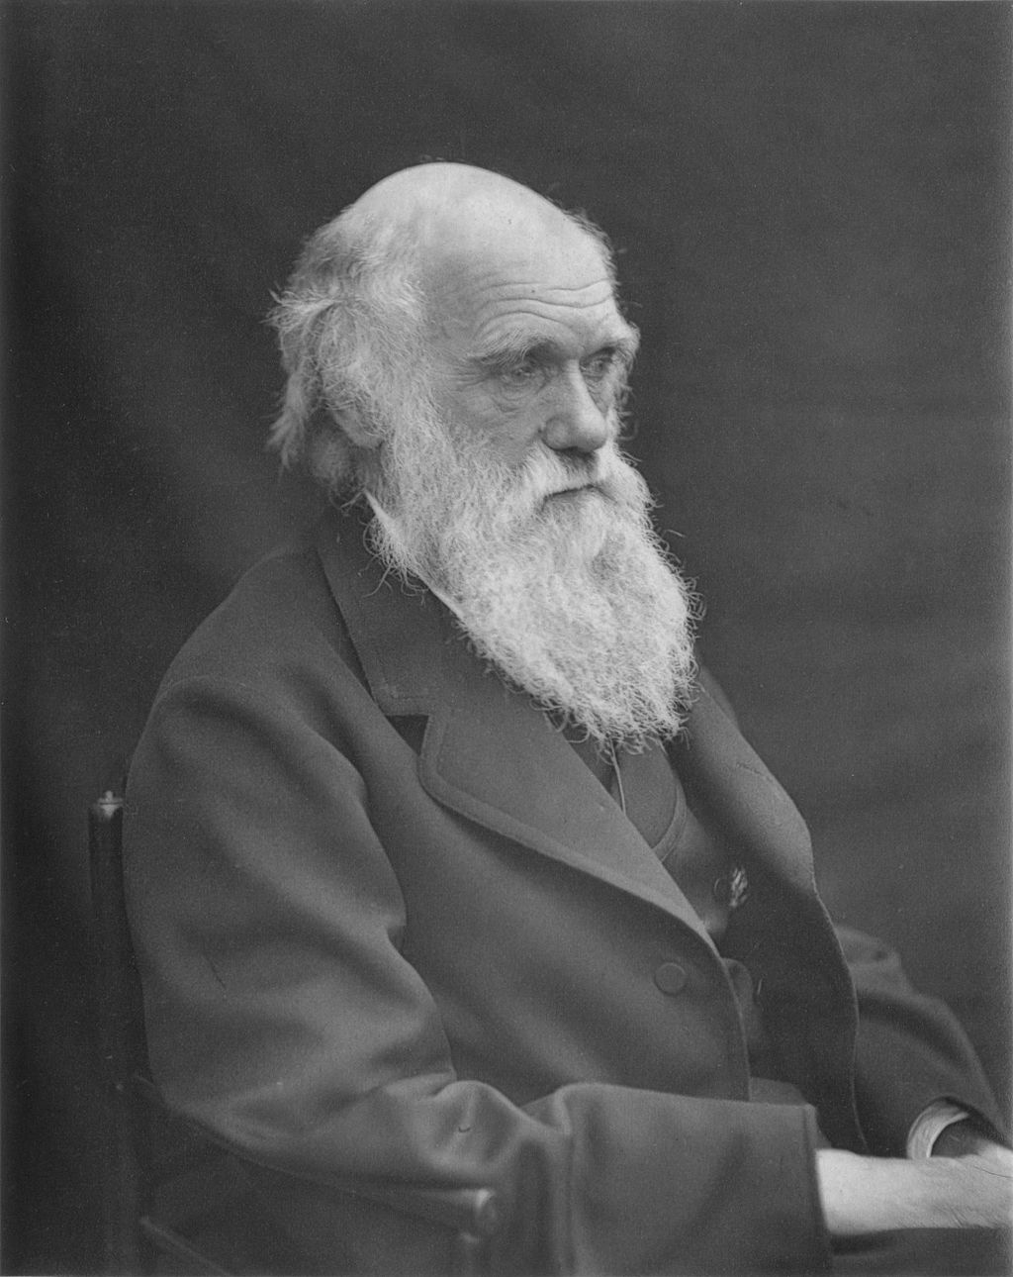
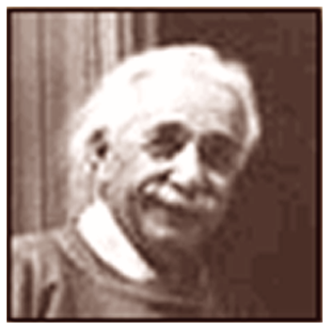
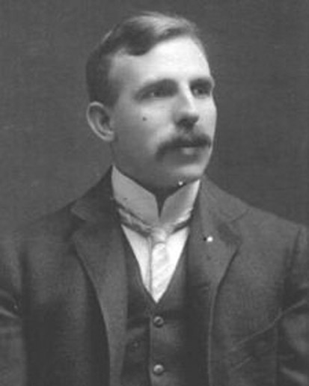
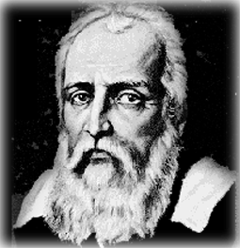
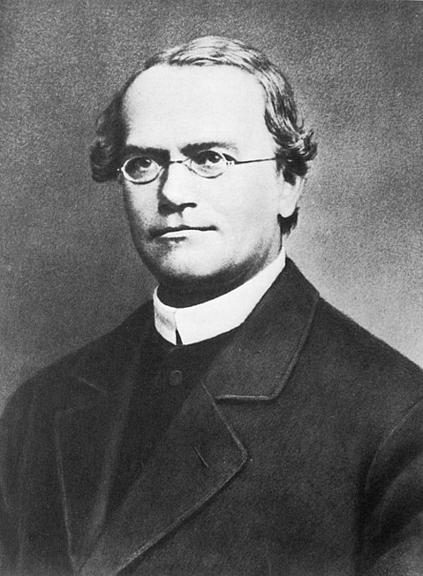
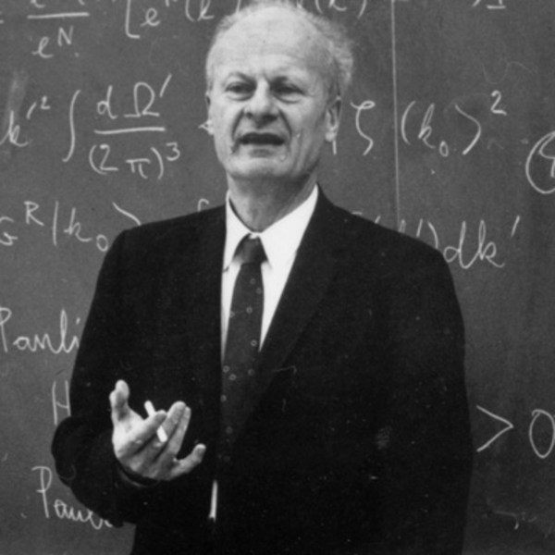
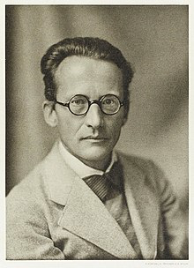
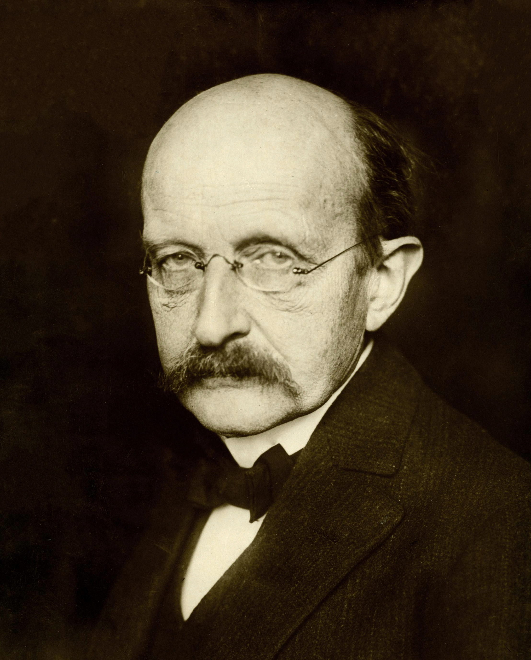
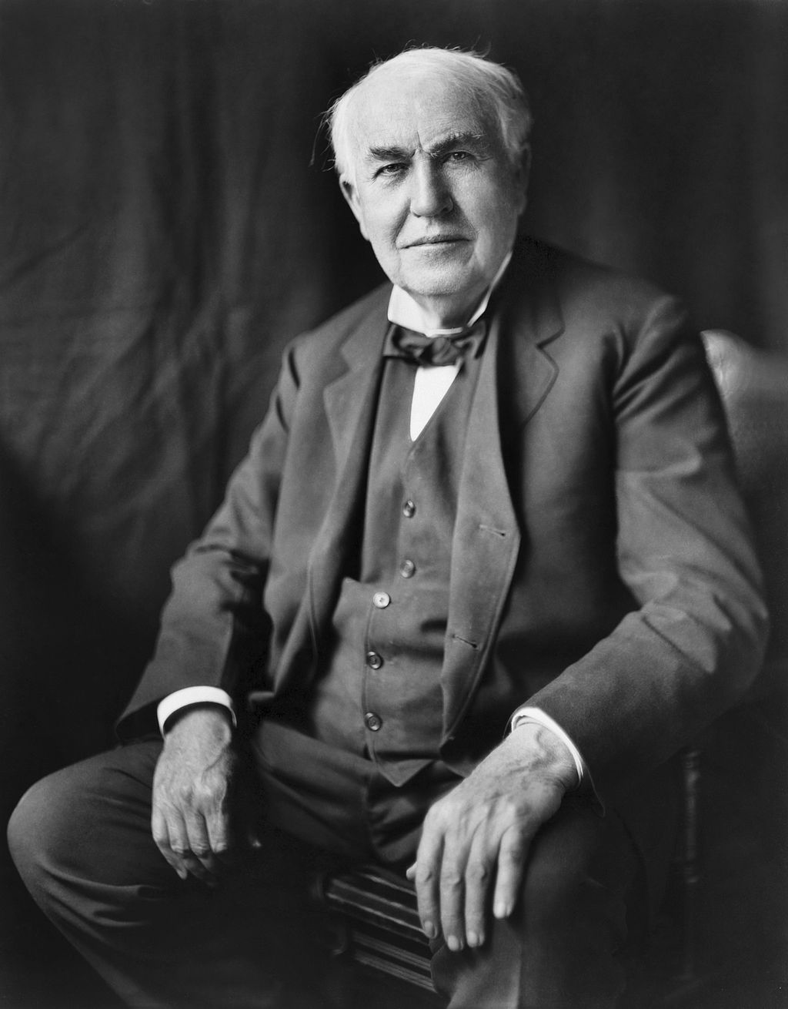
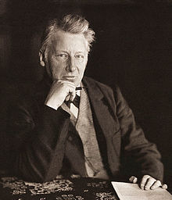
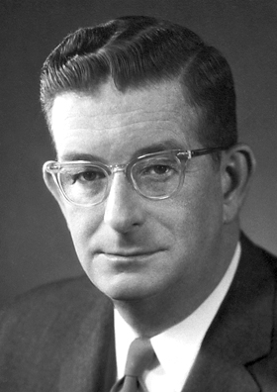
People make science
Images from Wikipedia

Slide 7
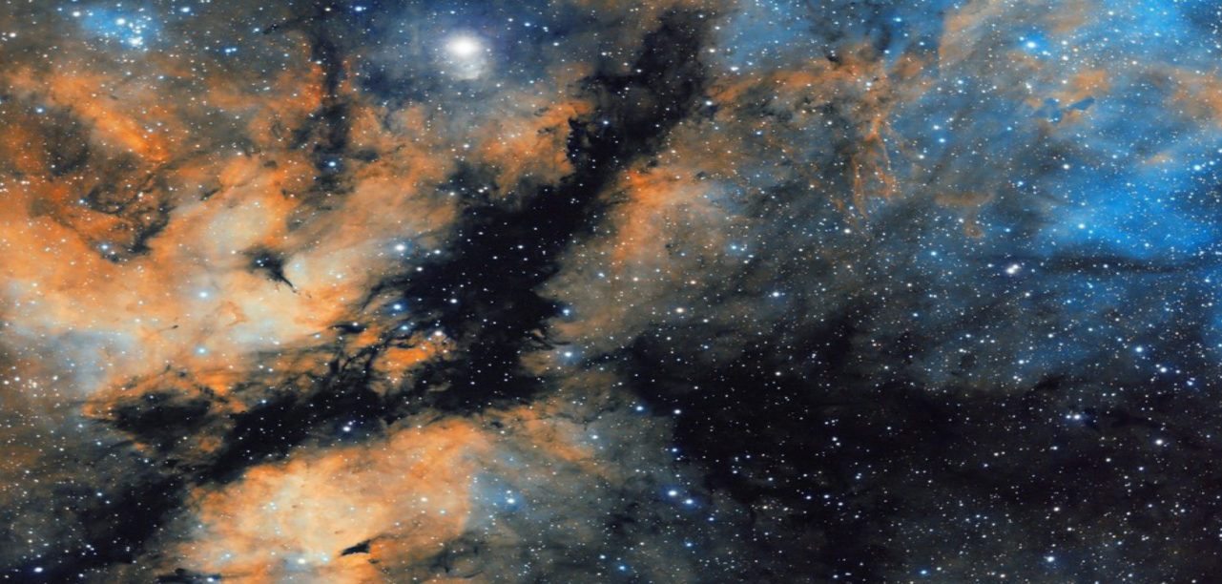
Science is being open
Image from Wikipedia

Slide 8
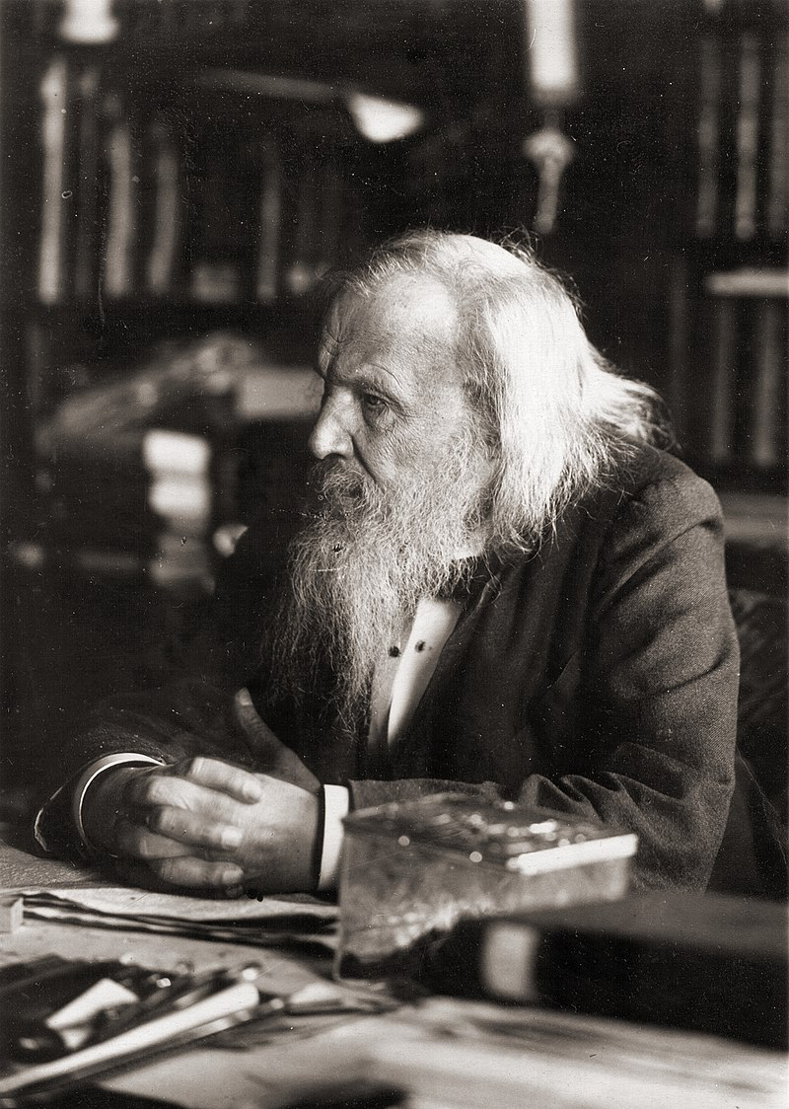
Science is endurance

Slide 9
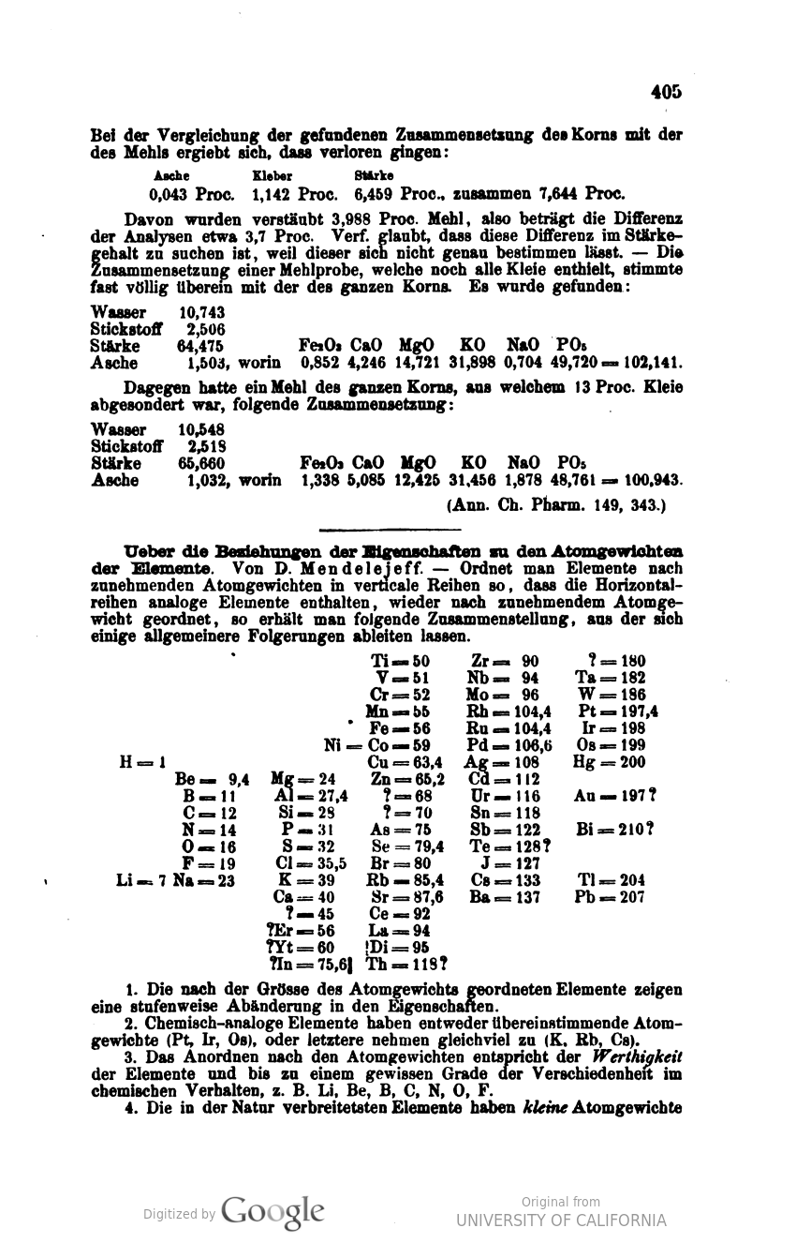
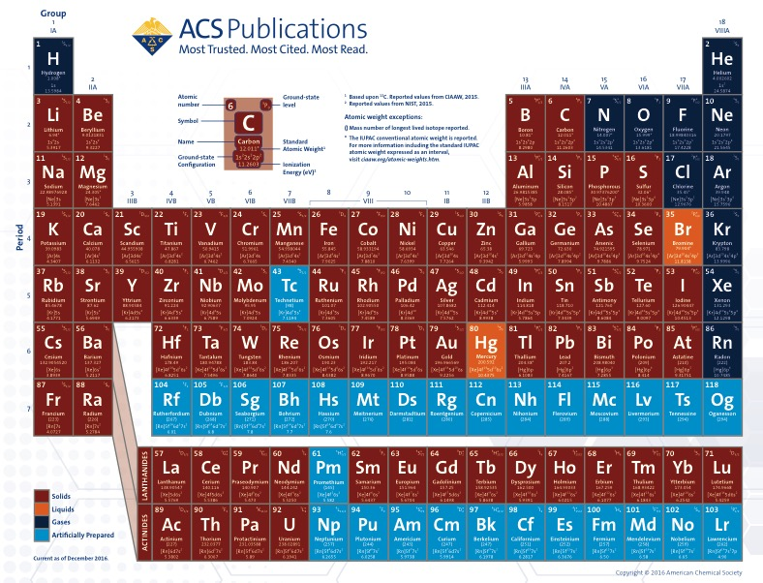

Slide 10
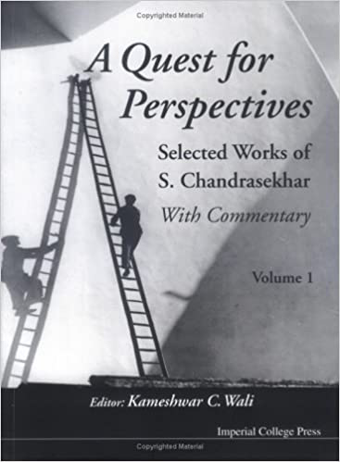
Ideas built the word!

Slide 11
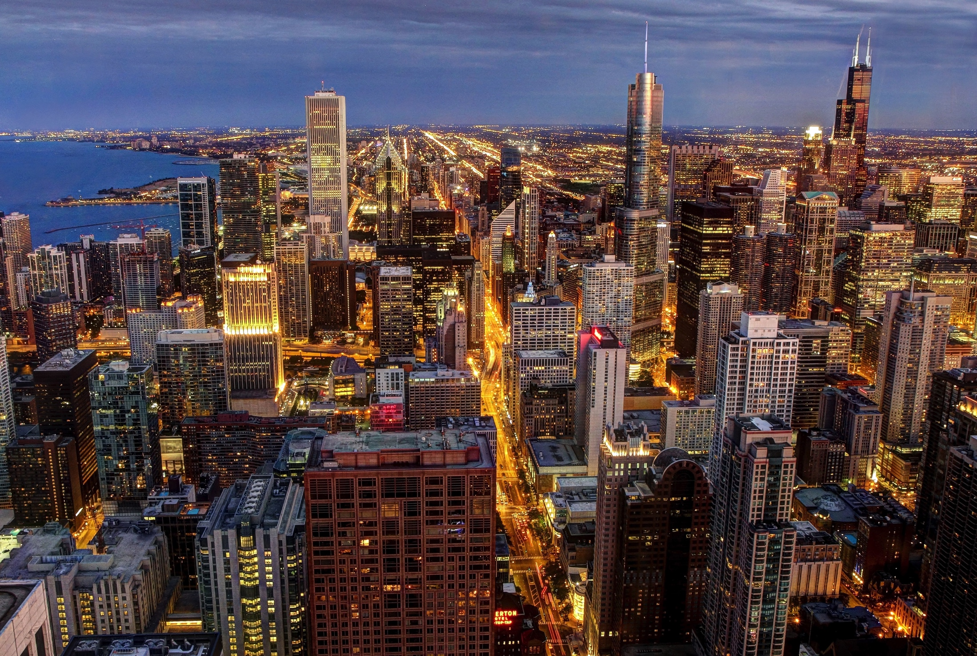
Image from Wikipedia

Slide 12
Excellence Vs. relevance
Publications Vs. patents

Slide 13
Science is very young
1800 No compound had been made by chemists.
The first compound was made in 1828.
1900 Atomic structure was not known.
The idea of the chemical bond was not known.
X-rays were not known.
Around 10,000 compounds were made by chemists.
We knew little about cells and nothing about the genetic code (DNA).
We had no rockets, TV, lasers, computers, mobile phones.
2000 We know almost everything about atoms and molecules.
Nine million compounds are known.
Genetic code and human genome (DNA) have been deciphered.
Space exploration has become common, mining in Moon
World is connected, distances have vanished.
2100 ?
Science and opportunities
Slide from CNR Rao with modifications

Slide 14
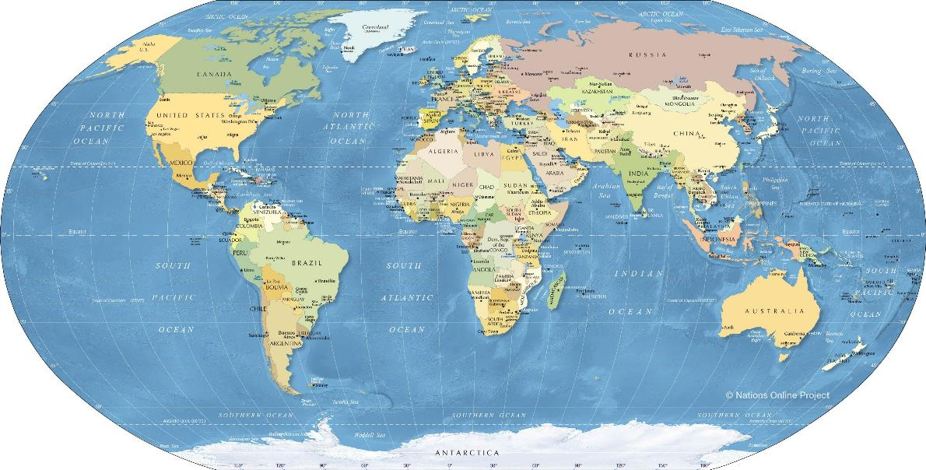
So much to discover
Total wealth of India – US$12.8 Trillion
Total wealth of USA – US$126 Trillion
With technology, an individual can own more than US$1 Trillion today!
Most of this wealth is due to technology

Slide 15
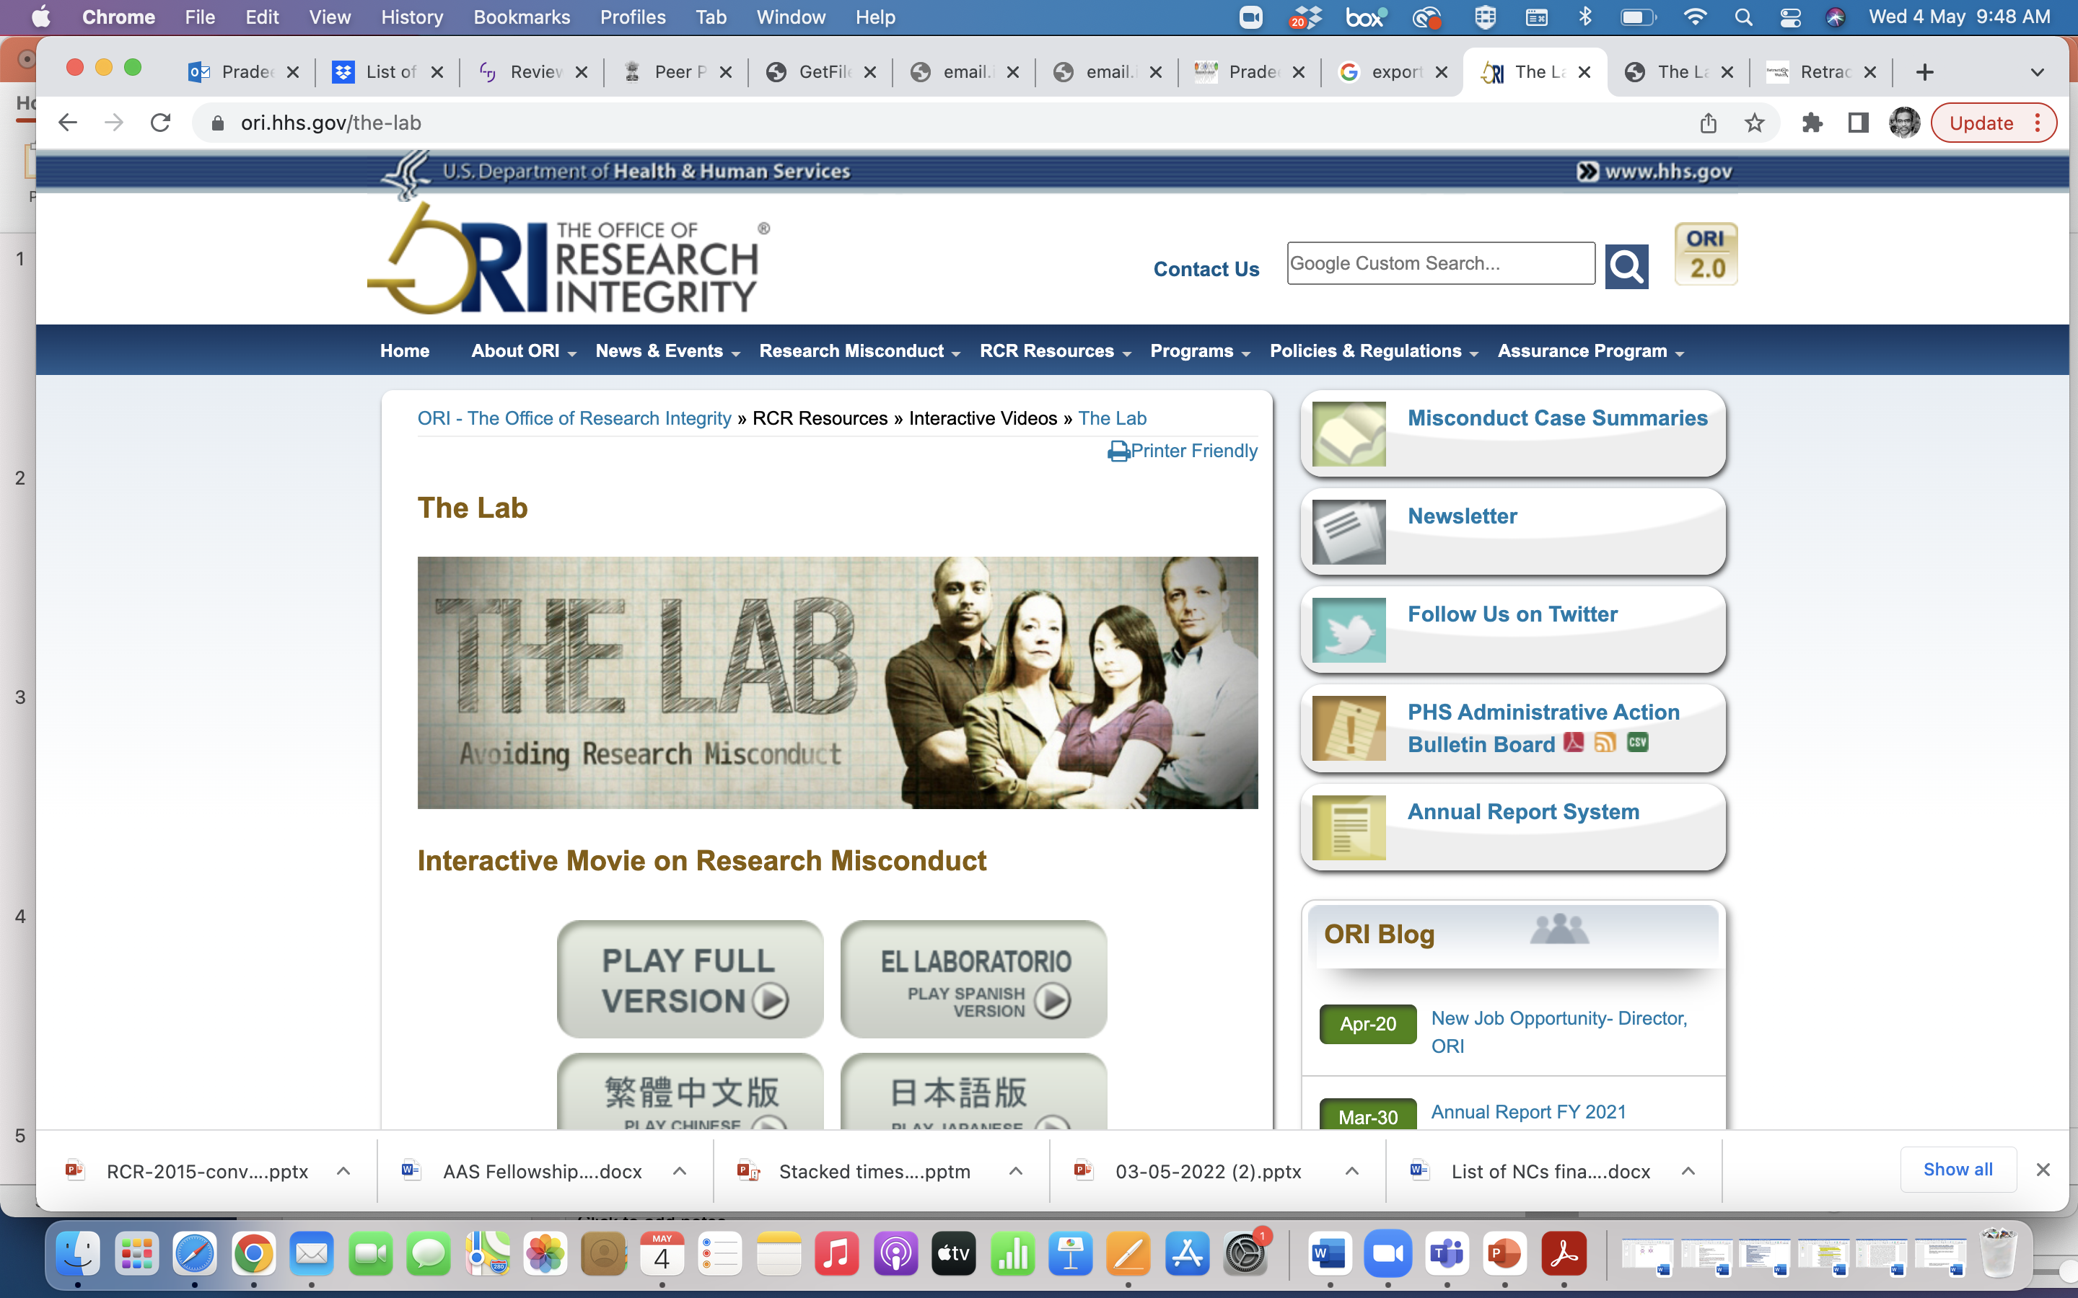
Research and pitfalls

Slide 16
https://ori.hhs.gov/TheLab/TheLab.shtml

Slide 17
I’m a good person.
Why do I need to worry about research ethics?
Good person can do good or bad Issue is about society Implications to society

Slide 18
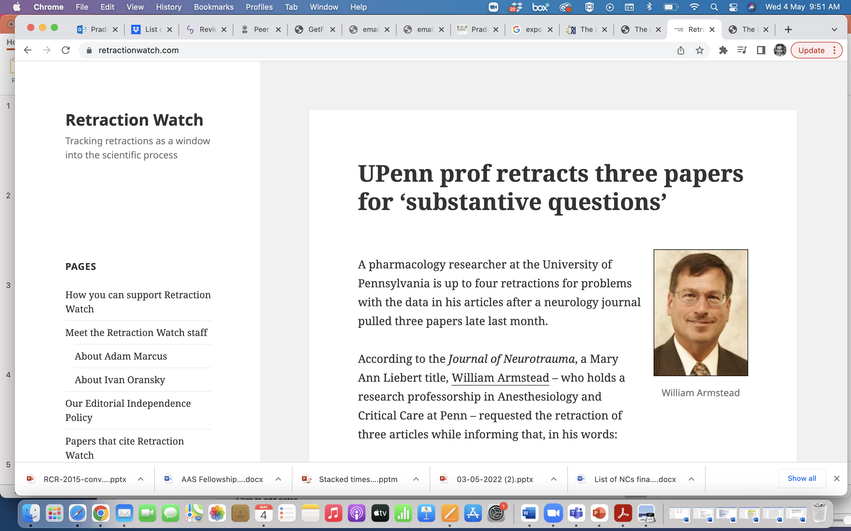

Slide 19
Good people do bad
Socially acceptable practices – copying for example
Accidents
Taking shortcuts
Missing details with digital services
Participation in others misconduct
Psychological conditions

Slide 20
Professional Pressures
Publish or perish
Survival
Peer pressure
Funding
Awards, rewards, recognition
Shortcuts to glory

Slide 21
What are the moral foundations of research?
How would institutions govern?
Fundamental principles
Doing good to humans, animals, the planet, future generations, etc. via the pursuit of truth and knowledge – live responsibly
Care for others
Democracy
Rules may be derived from these principles

Slide 22
Ethics and research
Research misconduct (falsification, fabrication and plagiarism)
Collaboration issues (authorship, data ownership and management) – Who should be an author?
Peer review – Who should review?
Conflicts of interest – Who should know? Who are you responsible to?
Complicity – Multiple involvement
Animal subject ethics
Human subject ethics

Slide 23
Examples of research misconduct
Image manipulation
Data fabrication or falsification
Data omission/suppression
Plagiarism
Sabotage

Slide 24
Affordable excellence in a college
Our competition is not with Oxford.
Excellence does not occur in isolation. Need for an ecosystem.
Key to excellence is people.
Excellence is nurtured.
Excellence has no caste, religion or race!
Excellence is beyond disciplines.
Excellence must be imbibed by the system as a whole.
Destroying excellence is simple.
Just bring the wrong person!

Slide 25
What is expected
Novelty
Quality
Understanding
Applications
Presentation
Language – scholarly writing
Originality
Plagiarism
Credits to people
How to get all these?
Simple answer is ‘people’.

Slide 26
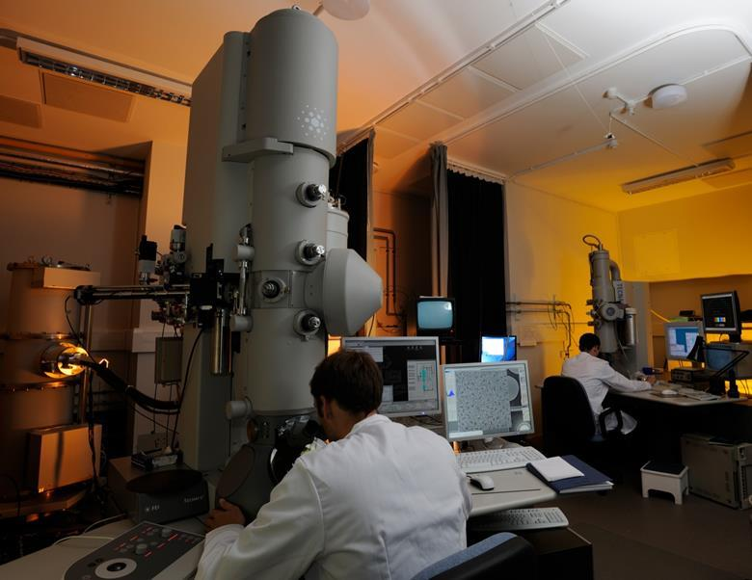
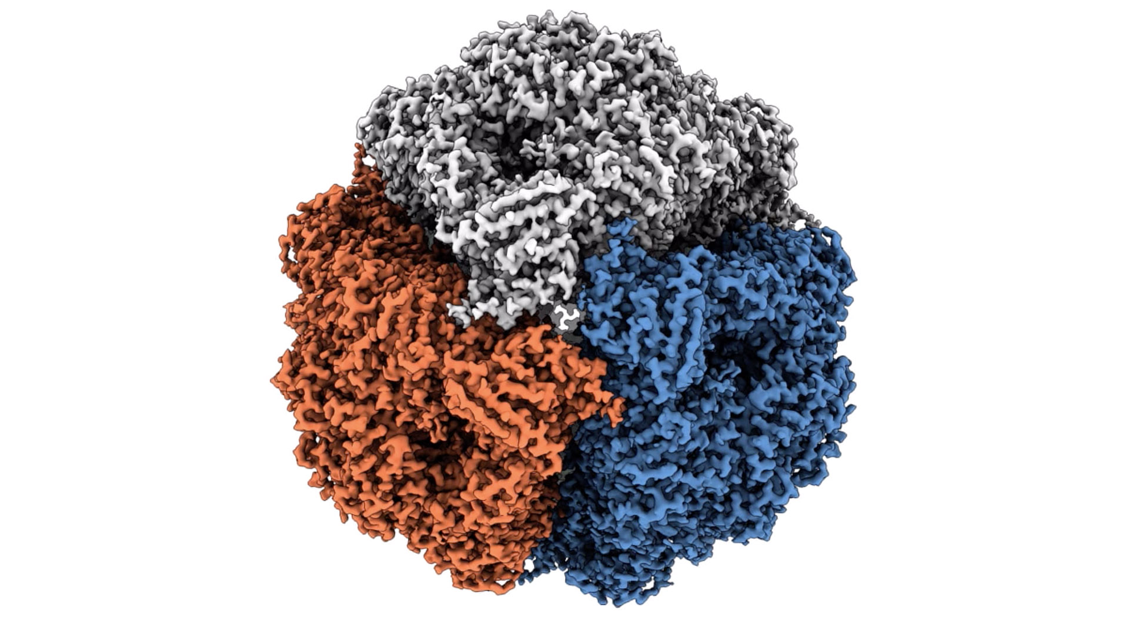
How about resources?
Urease, image EPFL
Source: MRC laboratory of Molecular Biology

Slide 27
Can we get there?
Impact?
Impact factor?
Get noticed?
Awards/rewards/fellowships
Never publish at lesser places
Publish at the right place
Can we have 10% papers in ACS/APS?
Increase gradually
Universities are not born in a day!

Slide 28

Thank you
Slides 17, 19-23 used inputs from the presentation of Lisa Rasmussen available at: https://graduateschool.charlotte.edu/sites/graduateschool.charlotte.edu/files/media/Lecture1ResearchEthics.pdf

Slide 29
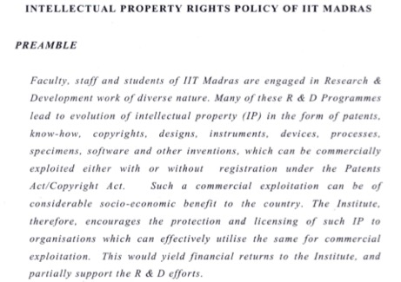
Intellectual property rights
Research produces knowledge
Knowledge is wealth
How to create wealth?
Protect intellectual property
Patents is one of the common ways for
protection
Disclose knowledge in the form of patent
Allows protection, commercialization
Intellectual property policy
Incubation policy

