Slide 1

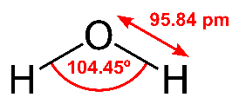

Since 1959
Welcome to IITM/IITMRP
Water@2047:
A glimpse into the challenges and opportunities
T. Pradeep
Institute Professor, IIT Madras
pradeep@iitm.ac.in
https://pradeepresearch.org
Professor-in-charge
Prof. Ashok Jhunjhunwala and colleagues
International Centre for Clean Water
Imagining India@2047 through innovation, IIT Madras, March 7-9, 2022

Slide 2
“Pale blue dot” Voyager 1 Feb. 14, 1990
Water is the most important inheritance of our planet

Slide 3
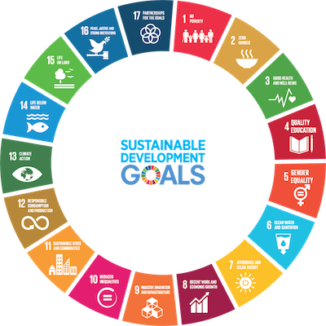
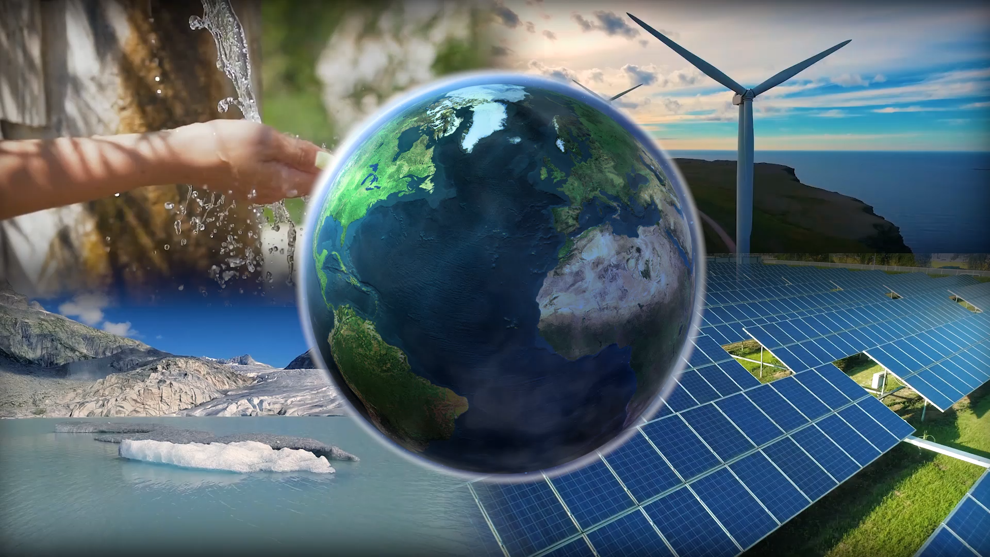
Water is at the entre of action
Variety and diversity are part of water, in problems and opportunities

Slide 4
Water is big and …. India is safe
Per capita water availability – 1500 CM
That water and its benefits need to reach all.
Peak water
Peter H. Gleick and Meena Palaniappan, PNAS, 2010, 107, 11155–11162
3Ss for water Store – Sensitive – Smart
Average rainfall 1085 mm, 85th in a list of 186 countries
Traditions of storage and conservation – we store just about 8%
Water is for all – for every living form
83% of freshwater species have declined globally in the last 50 years!
GDP can grow even by capping freshwater withdrawals
We must find technologies of relevance
Energy - food – clothing – construction – manufacturing - …..
Water is big in every scale – Gaps, opportunities, wealth, satisfaction

Slide 5
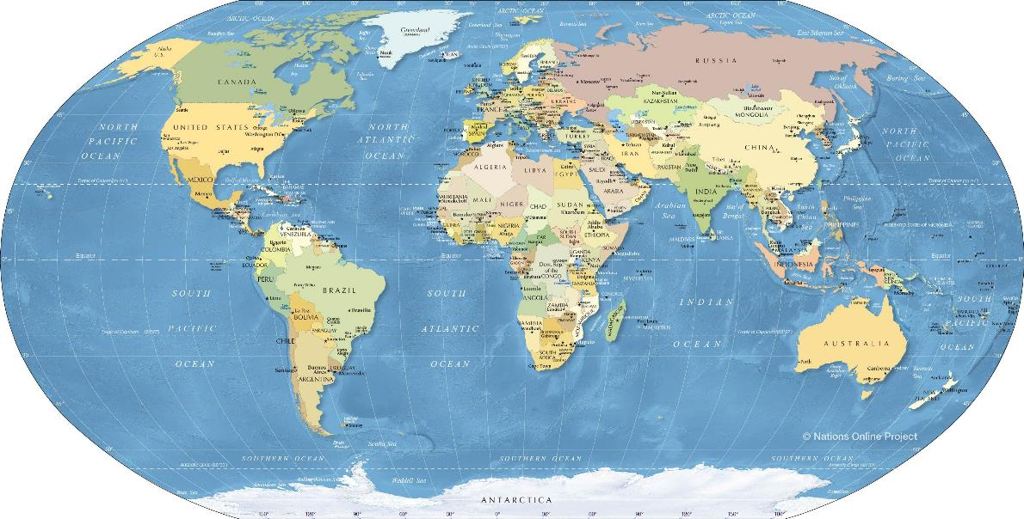
Water, sanitation and inequality
…total water infrastructure value for a connected global population of 9 billion people would amount to about US$60 trillion. M. Maurer, D. Rothenberger, T. A. Larsen, Water Sci. Technol. 5, 145–154 (2006)
With technology, an individual can own more than US$1 Trillion today!
…only 36% of the African population and 44% of the Asian population will be connected to a sewer network by 2050. G. Van Drecht, A. F. Bouwman, J. Harrison, J. M. Knoop, Global
Biogeochem. Cycles 23, GB0A03 (2009). doi:10.1029/2009GB003458
Agriculture makes a few percent of wealth in developed societies
Total wealth of India – US$12.8 Trillion
Total wealth of USA – US$126 Trillion

Slide 6
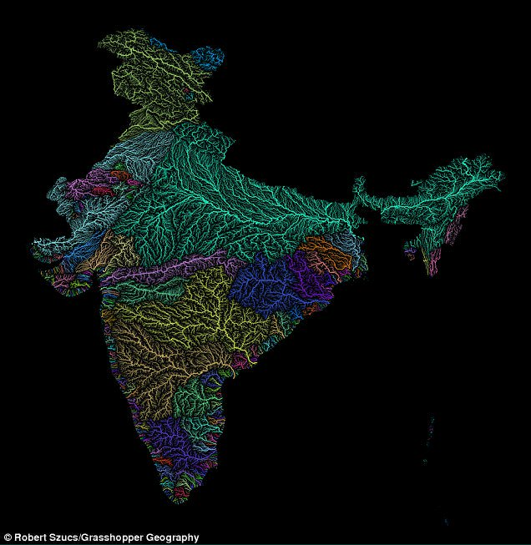
Challenges Every possible need
Arsenic
Fluoride
Uranium
Mercury
Chromium
Perchlorate
Nitrate
Pesticides
Antibiotics
Plastics
Detergents
…..
-45 ºC, 15% RH
Every river is contaminated
50% of the microbial diversity is lost for ever
Grooten, M.; Almond, R. E. A. Living Planet Report - 2018:
Aiming Higher; WWF: Switzerland, 2018.
From S. Vishwanath
+45 ºC, 99% RH

Slide 7
Indian agriculture
67% of agriculture run on GW
Total districts 742
Water stressed >300
256 with critical or overexploited ground water levels
‘India is suffering from its worst water crisis in its history.’
Data from NASA

Slide 8
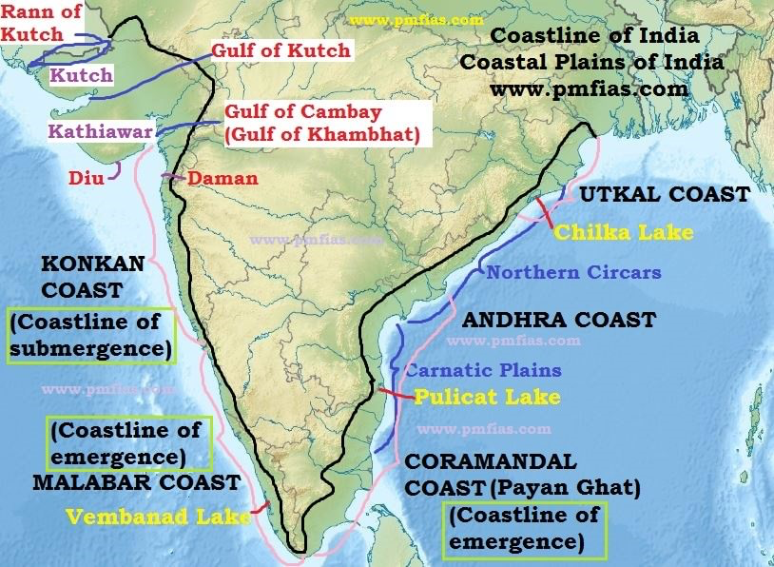
Technologies for water security
Membrane distillation
Capacitive deionization
Atmospheric water harvesting
Water recycling
Rainwater harvesting
Wastewater-based epidemiology
Nanobubbles and oxygenation
All on photovoltaics
https://www.pmfias.com/wp-content/uploads/2016/01/Coastline-of-India-–-Indian-Coastline.jpg

Slide 9
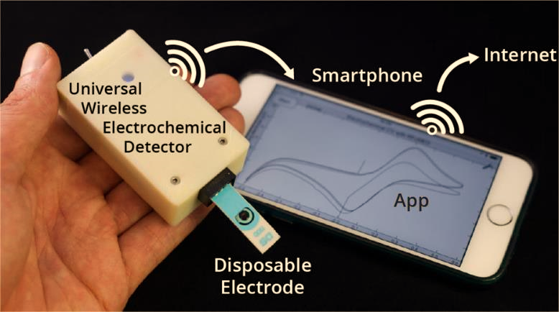
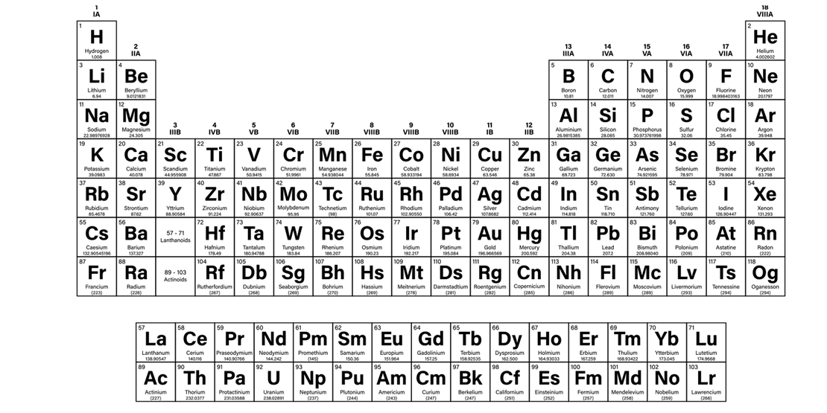

Sensing $1 trillion
Ainla A., et al. Analytical Chemistry, 90 (10), 2018.

Slide 10
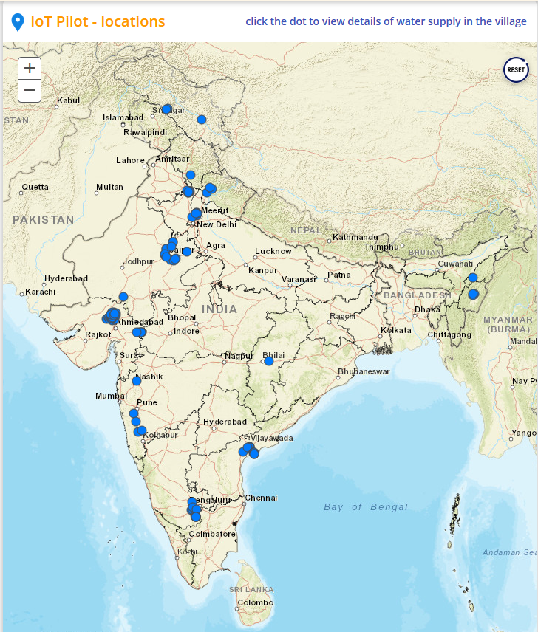
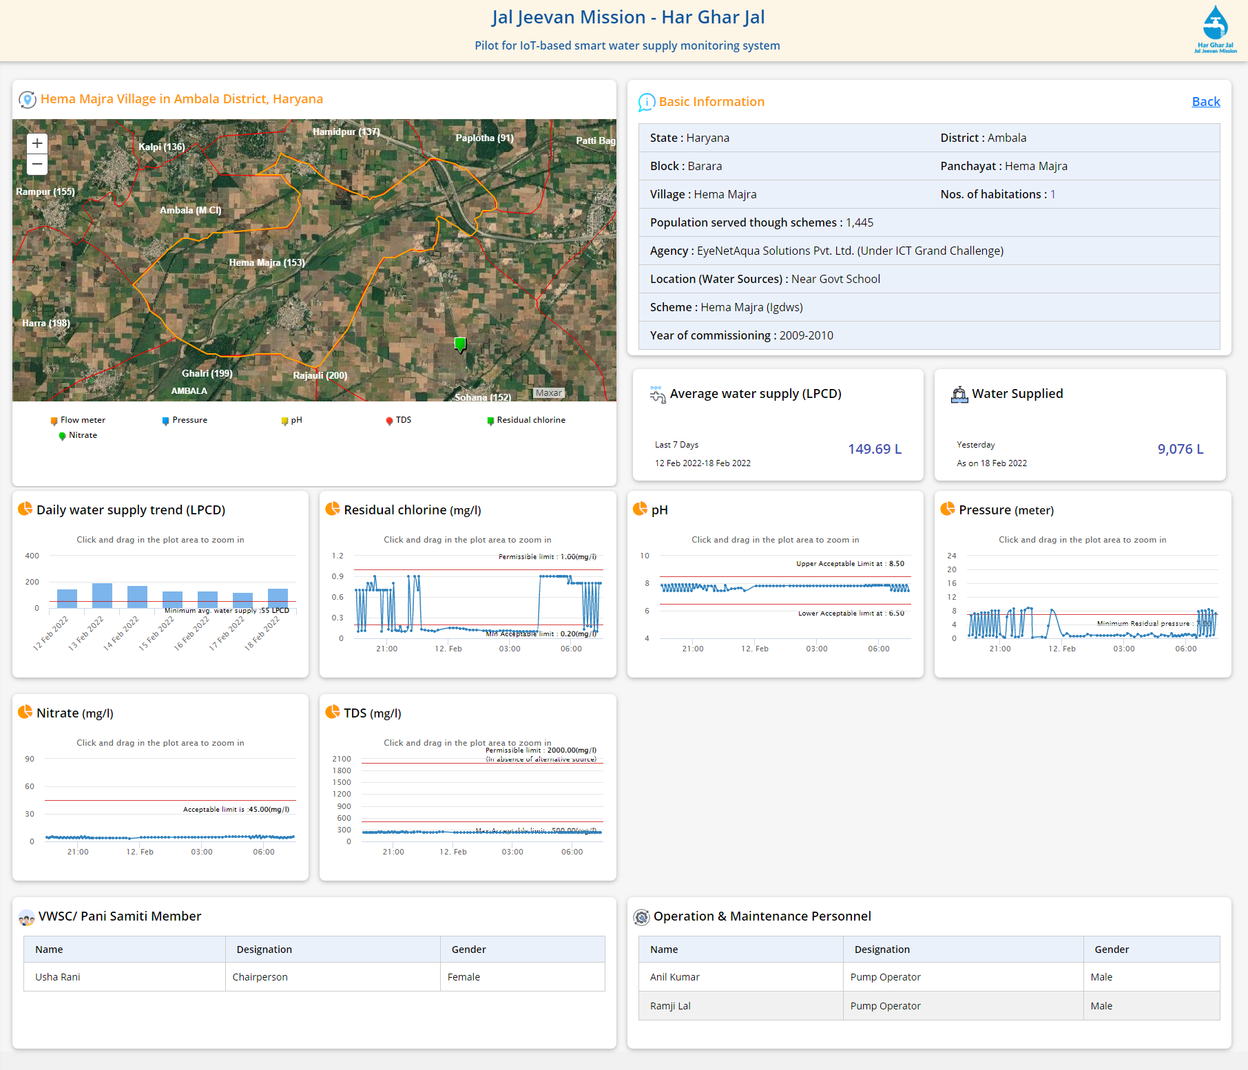
India’s water is being monitored
IITM/IISc
Installations made by four companies

Slide 11
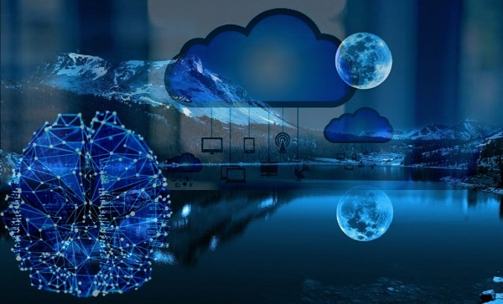
Hydroinformatics
Application of computing technologies for efficient, sustainable and equitable water management.
IoT and Cloud
VR/AR
Hydroinformatics
Cyber-physical systems
AI
Modelling and simulations
Blockchain

Slide 12
Water 4.0 Digital twin of water resources
Digital twin is the digital visualization and representation of a physical or natural system, which may gather data continuously from its physical counterpart and interact with it via a control system.
Create a digital twin of different elements of hydrologic environment – surface water bodies, ground water, rivers, and urban water utilities.
Data-driven modelling of events such as flood inundation of rural and urban areas with 3D visualization using the digital twin representation of the landscape.
Integration of real-time modelling of groundwater and surface water, water supply networks and utilities combined with analytics platform more accurate decision making.

Slide 13
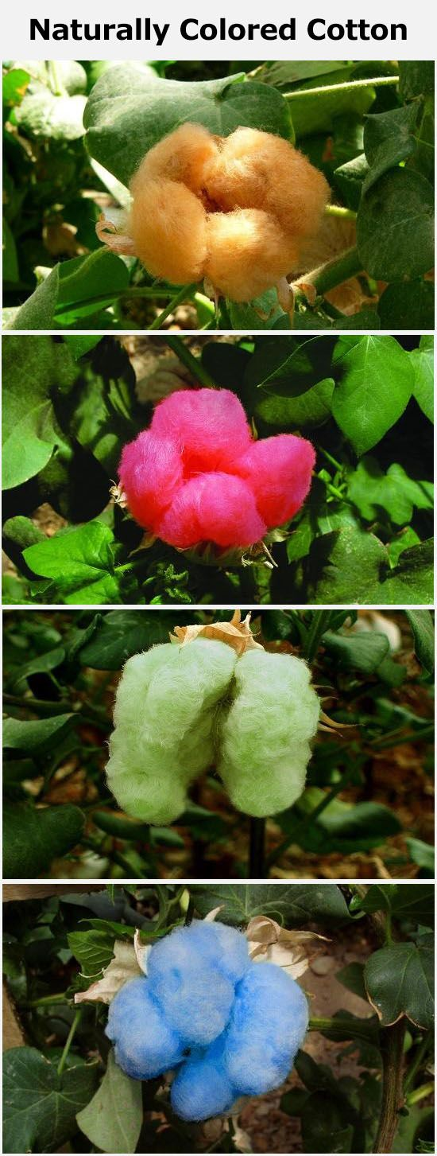
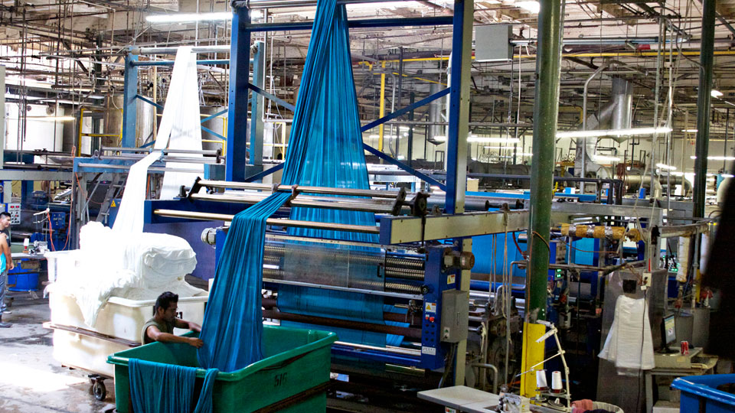
Traditional knowledge
https://www.unnatisilks.com/blog/naturally-colored-cottons-a-regain-in-popularity/

Slide 14
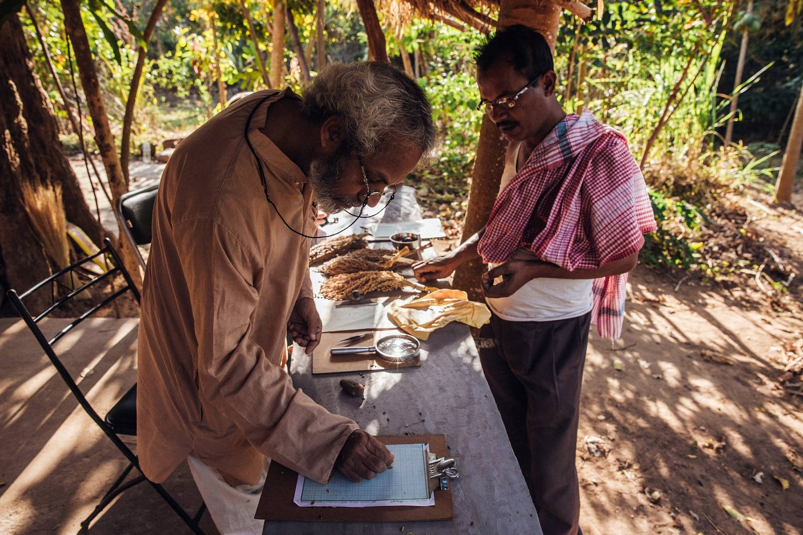
Arsenic free rice
Iron rich, silver rich, etc. rice
So much is happening on the ground

Slide 15
Policy

Slide 16

Our dreams become reality with materials
Energy
H₂O H₂O
Clean water
Affordable, inclusive, sustainable and contextual excellence
Discovery in 1825 by Danish physicist Hans Christian Ørsted, whose work was extended by German chemist Friedrich Wöhler. First industrial production by French chemist Henri Étienne Sainte-Claire Deville in 1856. In 1878, James Fern Webster was producing 100 pounds of pure Aluminium every week at his Solihull Lodge factory in Warwickshire, using a chemical process. In 1884, he established a trading title, Webster's Patent Aluminium Crown Metal Company Ltd. Aluminium became much more available to the public with the Hall–Héroult process developed independently by French engineer Paul Héroult and American engineer Charles Martin Hall in 1886, and the Bayer process developed by Austrian chemist Carl Joseph Bayer in 1889. These processes have been used for aluminium production up to the present.

Slide 17
Some simple calculations
Hydrogen + Oxygen → Water + 286,000 joules of energy per mole
1 kg of solar hydrogen is now at Rs. XX and could be Rs. 150 soon.
It can make 143 million J of energy.
Desalination needs 2.4 kWh or 8.84 million joules for 1 CM of water.
1 kg of hydrogen can therefore make 16.56 CM of water.
Or Rs. 9.06 per cubic meter, 0.9 paise per litre!
Well, add efficiency, other costs of plant, transportation, etc.
That world will need water literacy

Slide 18

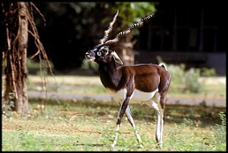
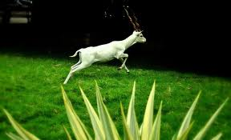
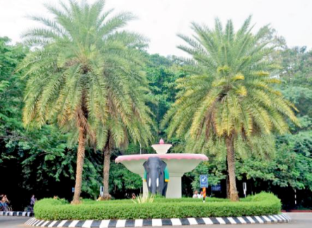
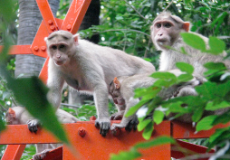
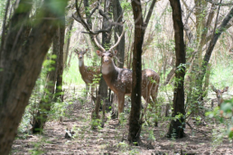




Indian Institute of Technology
Madras
Directors - past and present
Associate Editor
Thank you all

