Slide 1






Since 1959
Complexity in the Chemistry of Atomically Precise Clusters
T. Pradeep
Institute Professor, IIT Madras
https://pradeepresearch.org/
pradeep@iitm.ac.in
Co-founder
InnoNano Research Pvt. Ltd.
InnoDI Water Technologies Pvt. Ltd.
VayuJAL Technologies Pvt. Ltd.
Aqueasy Innovations Pvt. Ltd.
Hydromaterials Pvt. Ltd.
EyeNetAqua Pvt. Ltd.
Deepspectrum Analytics Pvt. Ltd.
Professor-in-charge
Associate Editor
International Centre for Clean Water
Indo-German mini-workshop-2022, Complex Chemical Systems (IGW-CCS-2022), IIT Madras, October 5, 2022

Slide 2
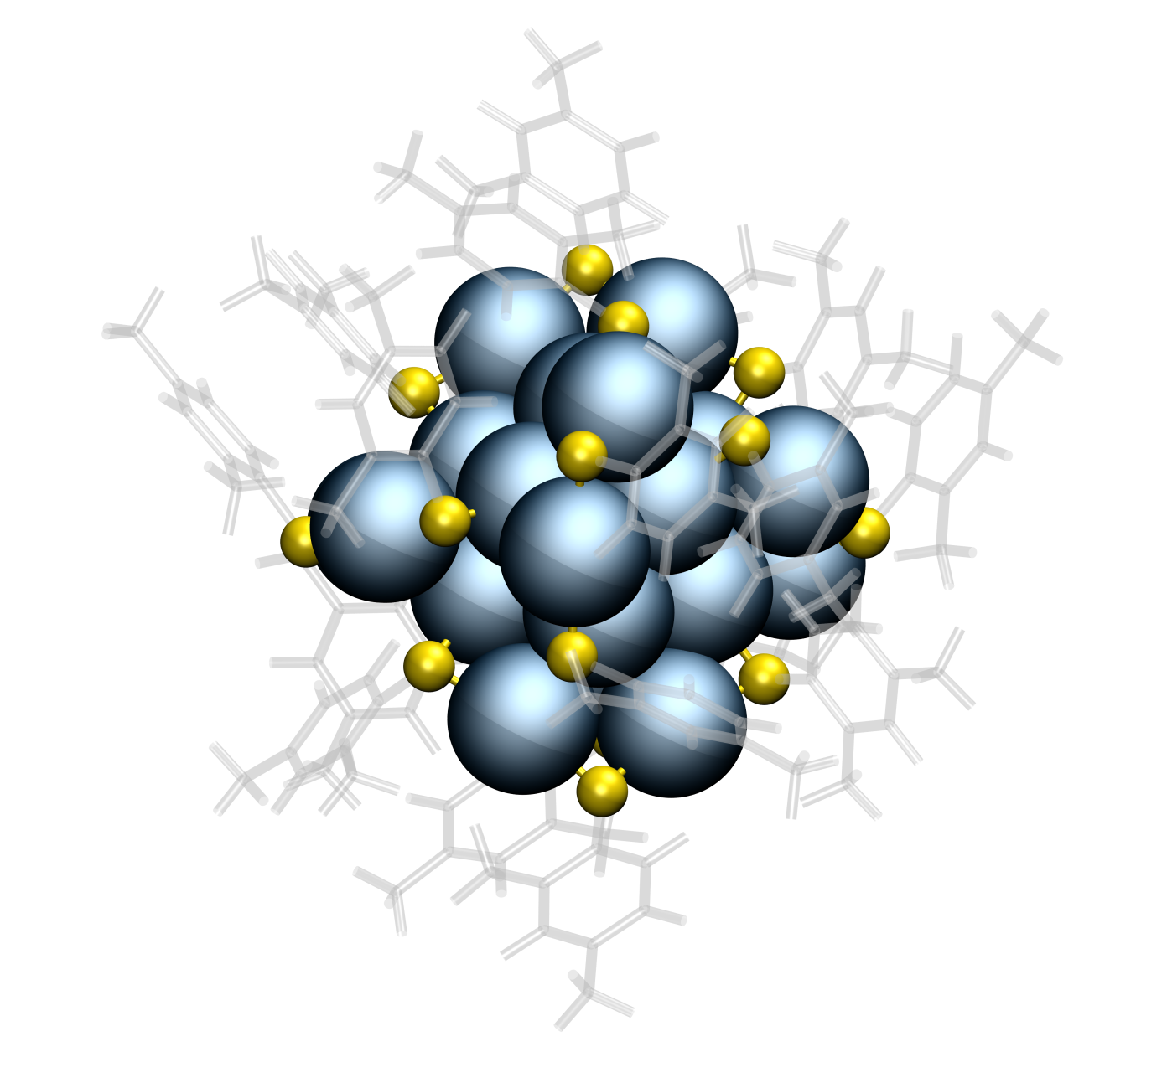
Au₂₅, Ag₂₅, Ag₂₉

Slide 3
Citations: >1200
Also the pioneering work of R. W. Murray, Robert L. Whetten, Uzi Landman, Tatuya Tsukuda, Yuichi Negishi, Hannu Hakkinen,
Rongchao Jin, Nanfeng Zheng, Terry Bigioni, Osman Bakr, Kornberg, Jianping Xie, C. M. Aikens, Thomas Buergi, Amala Dass, Ackerson, De-en Jiang, …. A. W. Castleman Jr., H. Schmidbauer, …. Robin Ras, Olli Ikkala
…Manfred Kappes, Horst Hahn

Slide 4
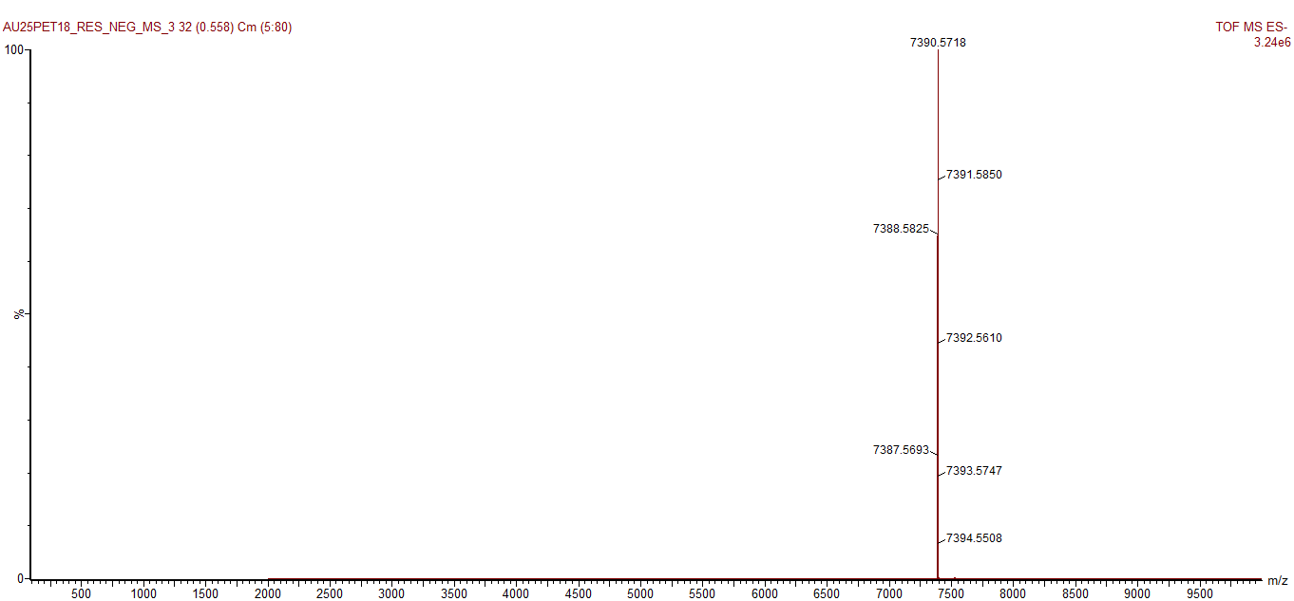
Molecular formula, Molecular weight
Au₂₅L₁₈⁻
Au₃₈SR₂₄
Au₁₀₂SR₄₄

Slide 5
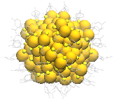
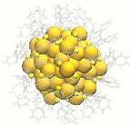
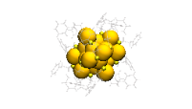
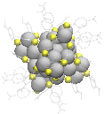
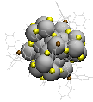
Ag₂₉(BDT)₁₂³⁻
Ag₂₅(DMBT)₁₈⁻
Au₂₅(PET)₁₈⁻
HRMS of Au₂₅(PET)₁₈⁻
m/z

Slide 6
They make high quality crystals

Slide 7
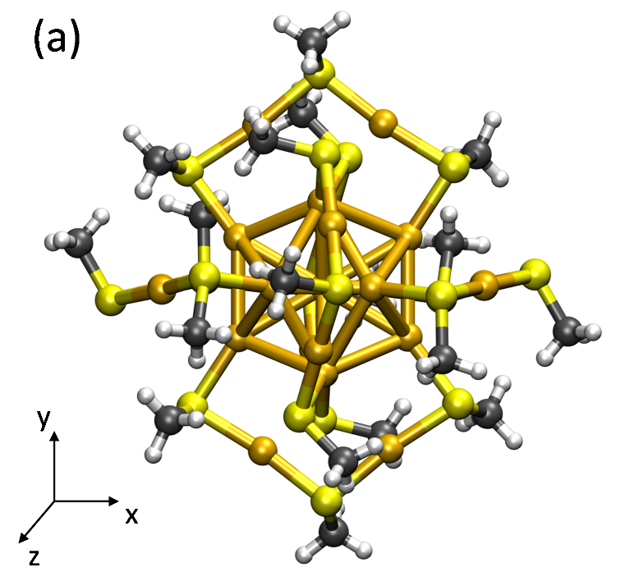
Molecular structure
Geometric and electronic shells
Gana Natarajan

Slide 8
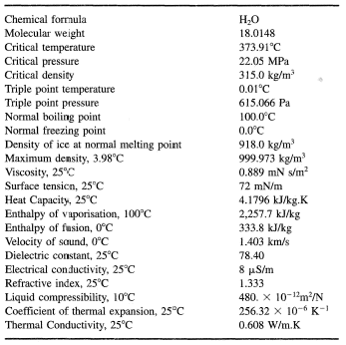
Molecules and their properties

Slide 9
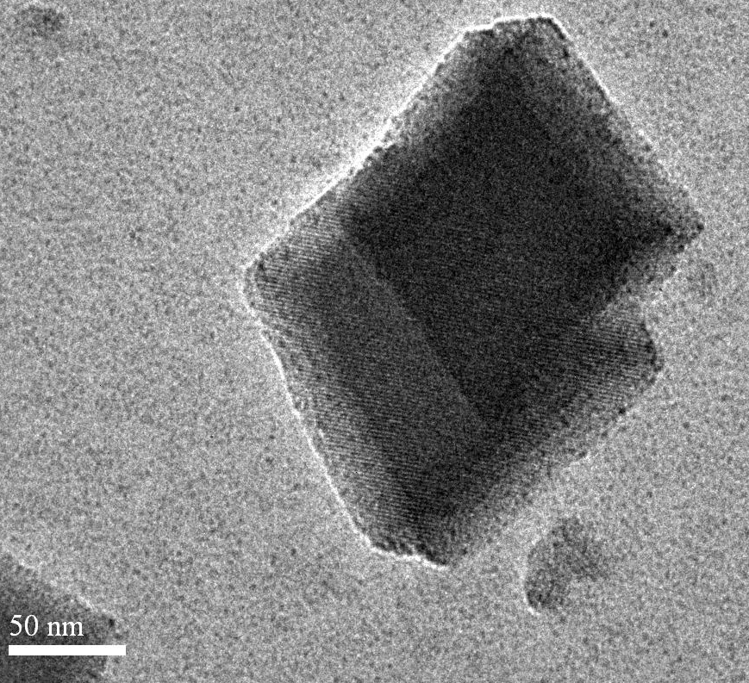

Slide 10
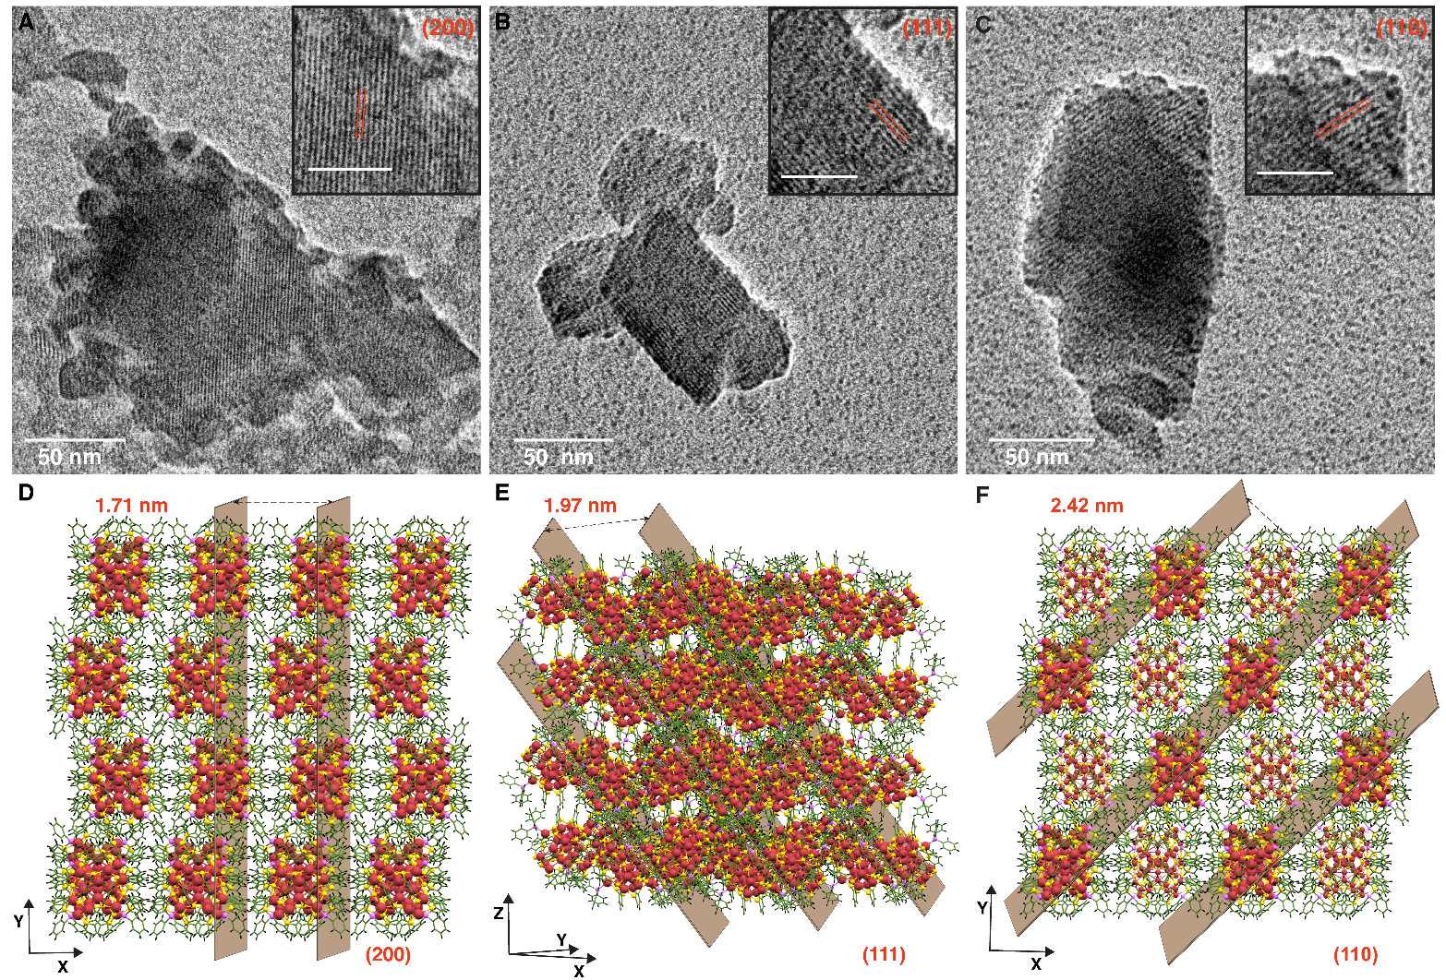
Ananthu Mahendranath et al. Chem.Comm.2021

Slide 11
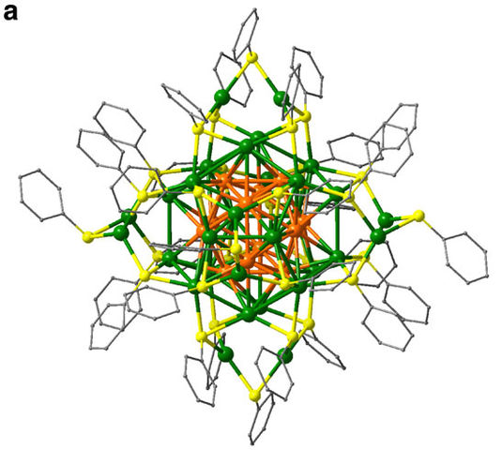
Ag₄₄
Nanfeng Zheng et al. Nature Communications, 2013
Terry Bigioni et al. Nature 2013

Slide 12
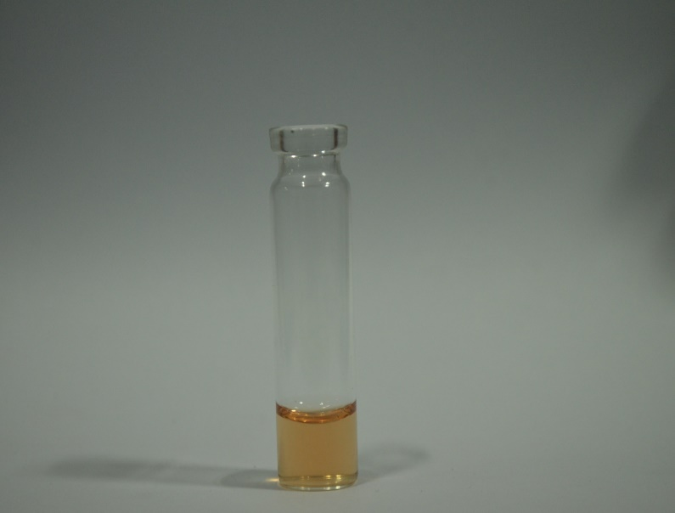
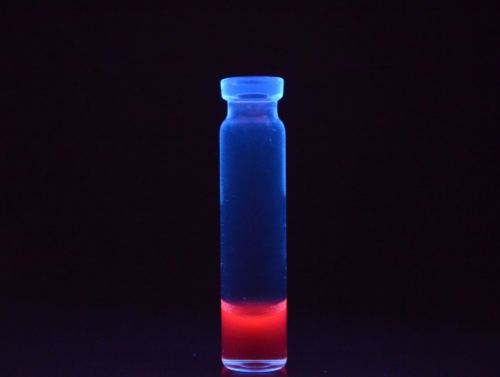
Molecular reactions
Reactions on clusters
Reactions between clusters

Slide 13
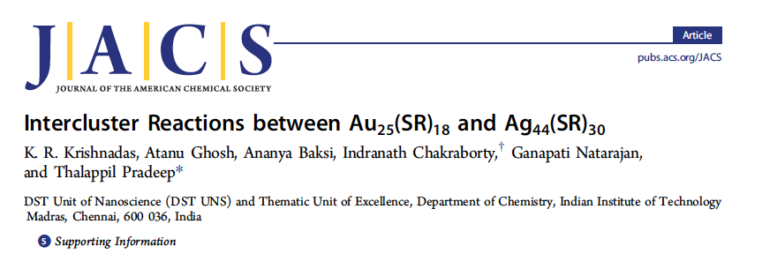
Inter-cluster reactions
A + B → C + D

Slide 14
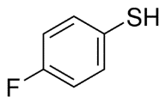
Au₂₅(FTP)₁₈ + Ag₄₄(FTP)₃₀ Au_{25-x}Ag_{x}(FTP)₁₈

Slide 16
Energies for the substitution reaction of (A) Au in Ag₄₄(SR)₃₀, (B) Ag in Au₂₅(SR)₁₈ and (C) the overall reaction energies (in eV) as a function of their positions in product clusters, Au_{x}Ag_{44-x}(SR)₃₀ and Au_{25-x}Ag_{x}(SR)₁₈ for x=1

Slide 17
Ag₂₅-Au₂₅ experiments
K. R. Krishnadas et al. Nature Commun. 2016

Slide 18
Reaction between Au₂₅(PET)₁₈ and Ag₂₅(DMBT)₁₈
DMBT
PET

Slide 19
[Ag₂₅(DMBT)₁₈+Au₂₅(PET)₁₈]²⁻
DMBT
PET
Ag₂₅(DMBT)₁₈
[Ag₂₅(DMBT)₁₈+Au₂₅(PET)₁₈]²⁻
Au₂₅(PET)₁₈

Slide 20
Evolution of alloy clusters from the dianionic adduct,
[Ag₂₅Au₂₅(DMBT)₁₈(PET)₁₈]²⁻
within 5 min
Ag₂₅(DMBT)₁₈:Au₂₅(PET)₁₈
0.3:1.0
within 2 min

Slide 21
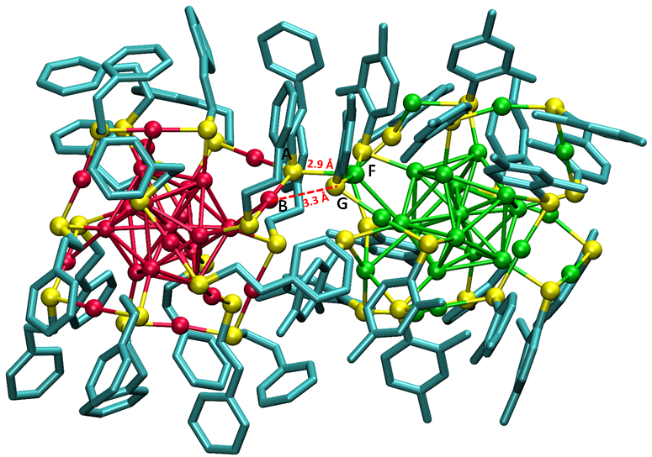
Optimized structure of [Ag₂₅Au₂₅(DMBT)₁₈(PET)₁₈]²⁻

Slide 23
How do we comprehend this?

Slide 25
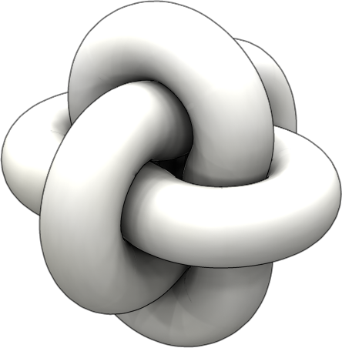
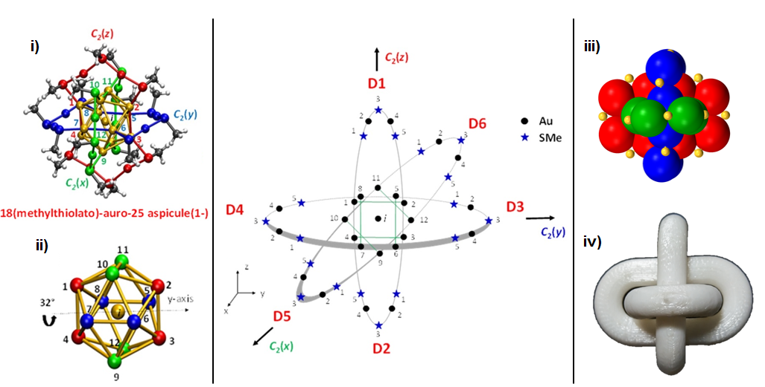
Gana Natarajan et. al. JPC C 2015

Slide 26
Aspicules

Slide 27
(D1-3,D2-3)-di(2-phenylethylthiolato),16(methylthiolato)-auro-25 aspicule(1-)
(D1-3,D2-3)-(PET)₂,(SMe)₁₆-auro-25 aspicule(1-)

Slide 28
3
y
Ligand Exchange & Alloy cluster
Au
2
4
z´
Au₂₄Pd(SR₁)₁₀(SR₂)₈ isomer 1 (cis)
1, 5-(SBB)₁₀, 3-(SC₆H₁₂)₈
(i, 1, 2, x2)-palladoauro-25 asp (-1)
1
5
S
2
3
1
4
11
5
4
1
5
1
4
5
6
2
x
x´
10
i
12
3
3
2
8
7
4
1
5
5
3
2
9
y
4
1
1
x
z
3
2
5
z
4
2
y´
3

Slide 29
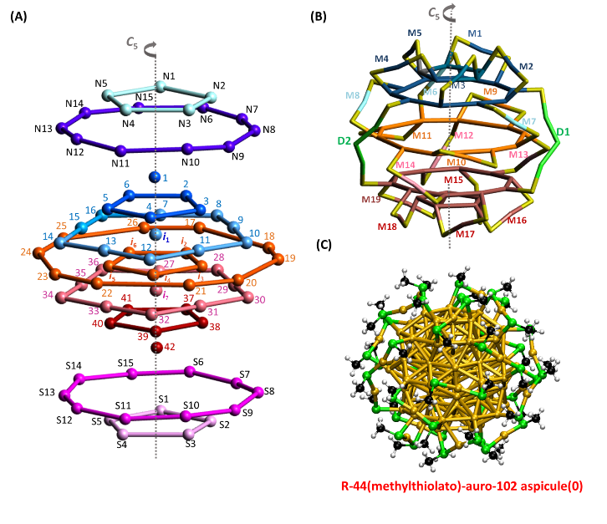
R-(SMe)₄₄-auro-102 aspicule(0) and L-(SMe)₄₄-auro-102 aspicule(0)

Slide 31
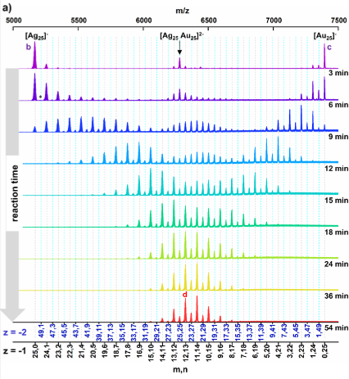
Manfred Kappes, KIT
M. Neumaier, A. Baksi, et. al., JACS 2021

Slide 32
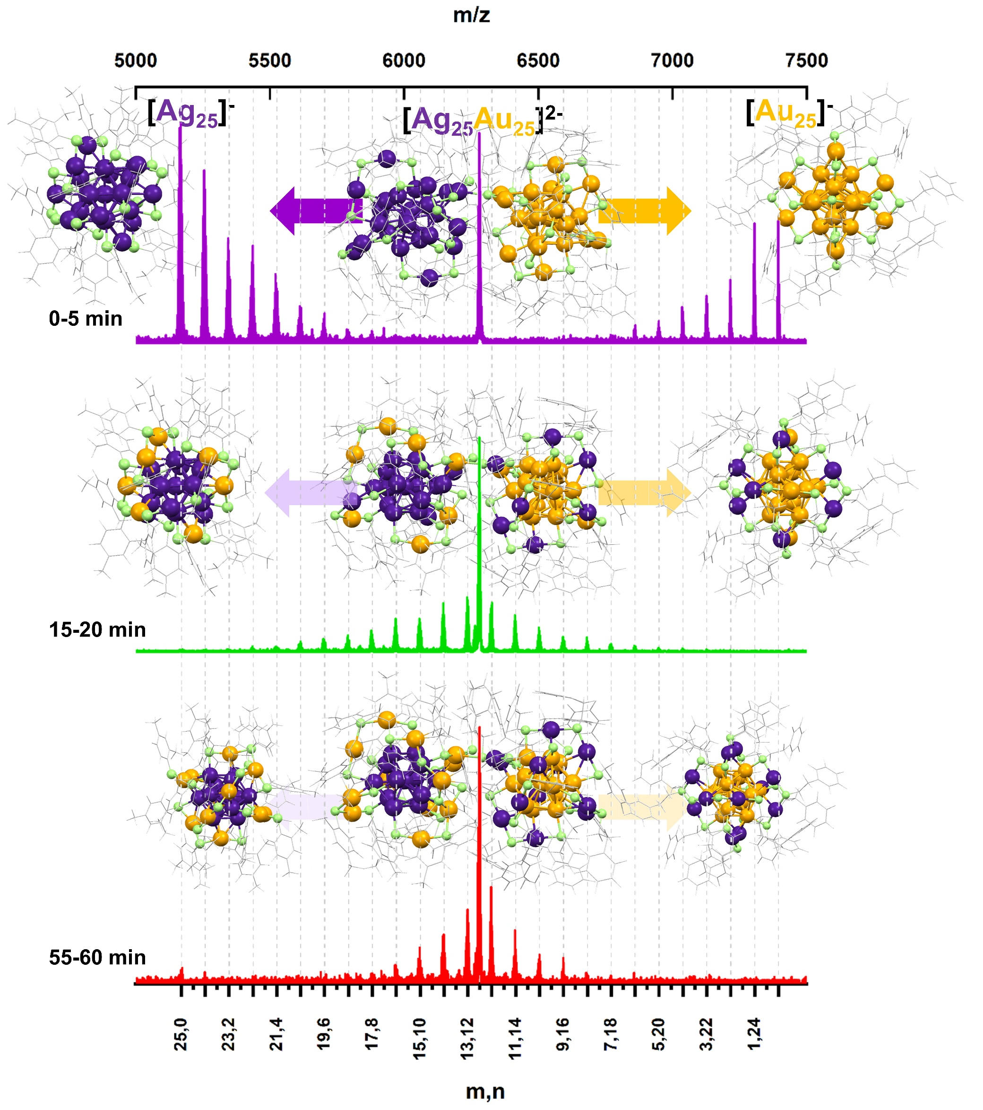
CID data of [Au25Ag25]²⁻

Slide 33
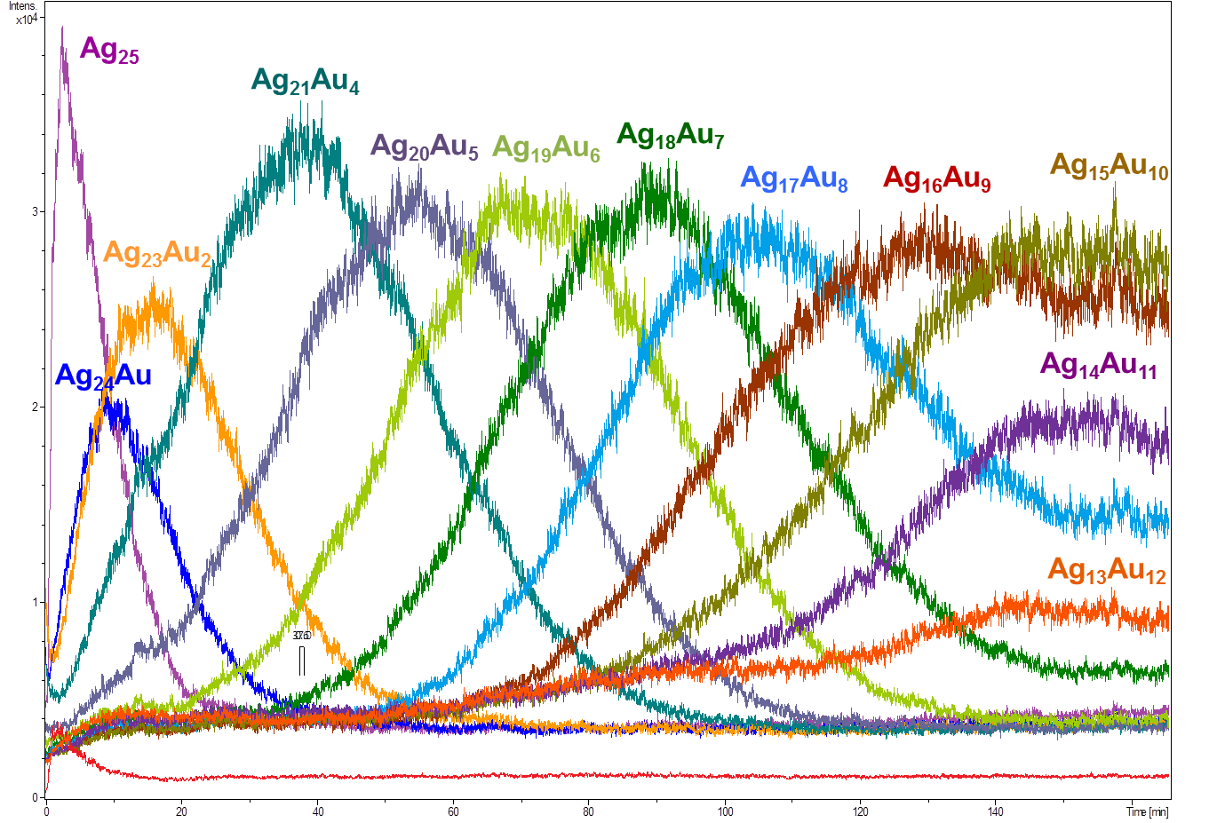
Kinetics of the exchange (monitored on the Ag₂₅ side)

Slide 34
Expanding reactions

Slide 36
Interparticle reactions forming product co-crystals

Slide 37
Co-crystals
Ag₄₀ and Ag₄₆ with the same shell
M. Bodiuzzaman, et. al. Angew. Chem. Int. Ed. 2018

Slide 38
Atom transfer dynamics
They are indeed molecules!

Slide 40
ESI MS of A) ¹⁰⁷Ag₂₅(DMBT)₁₈ and B)¹⁰⁹Ag₂₅(DMBT)₁₈. Insets shows the respective isotope patterns.

Slide 41
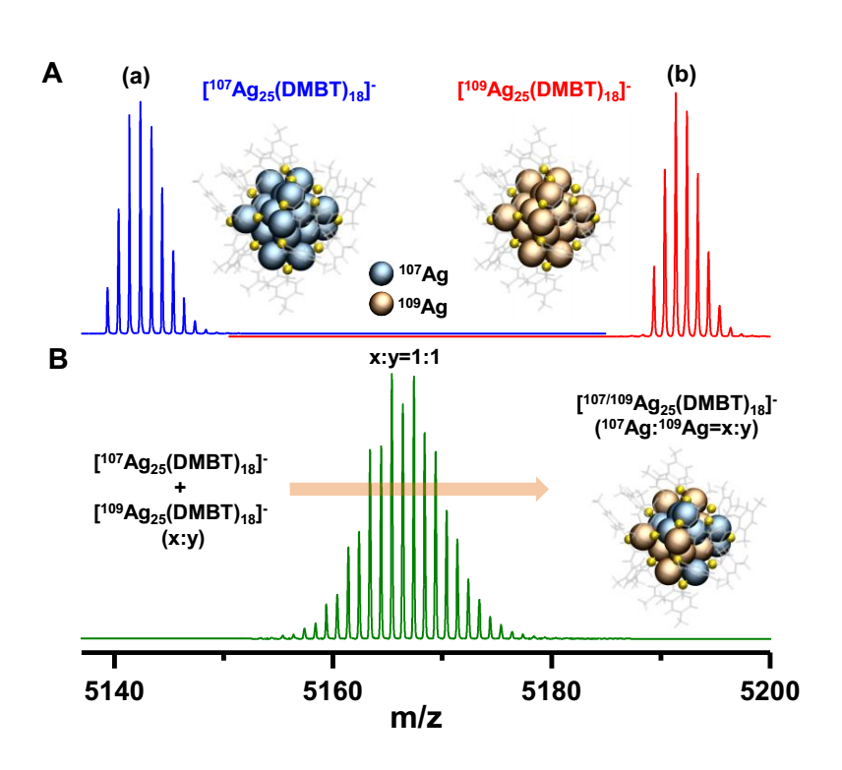

Slide 42
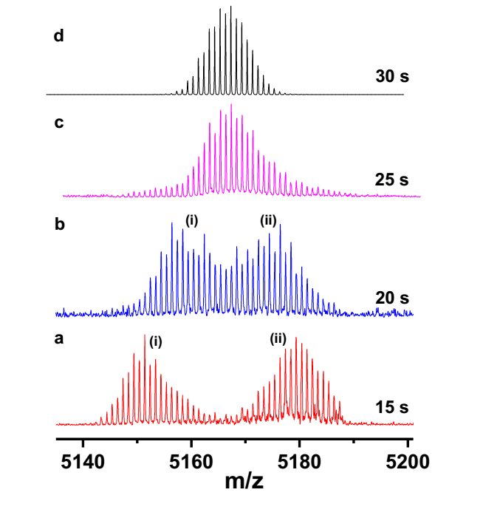
Papri Chakraborty, et. al. Science Advances 2019

Slide 43
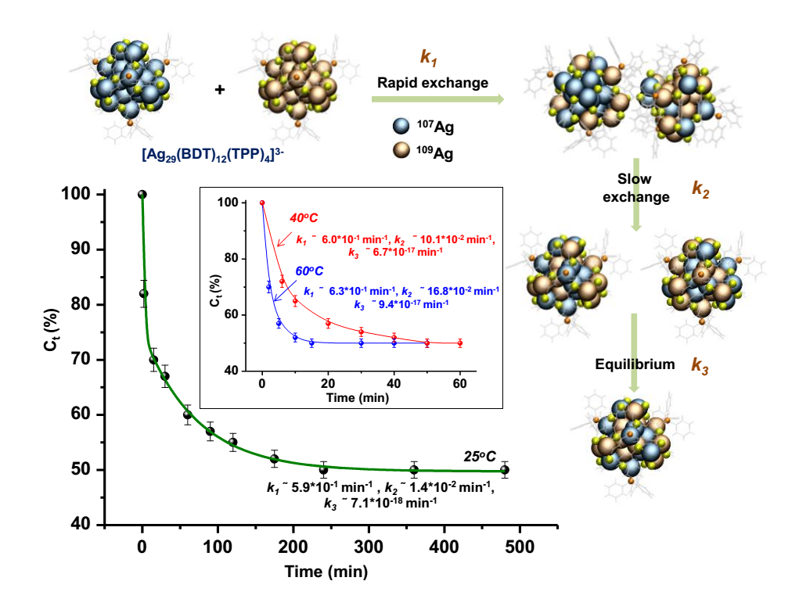

Slide 44
Can clusters react with nanoparticles?

Slide 45
Paulami Bose et al. Nanoscale 2020

Slide 46
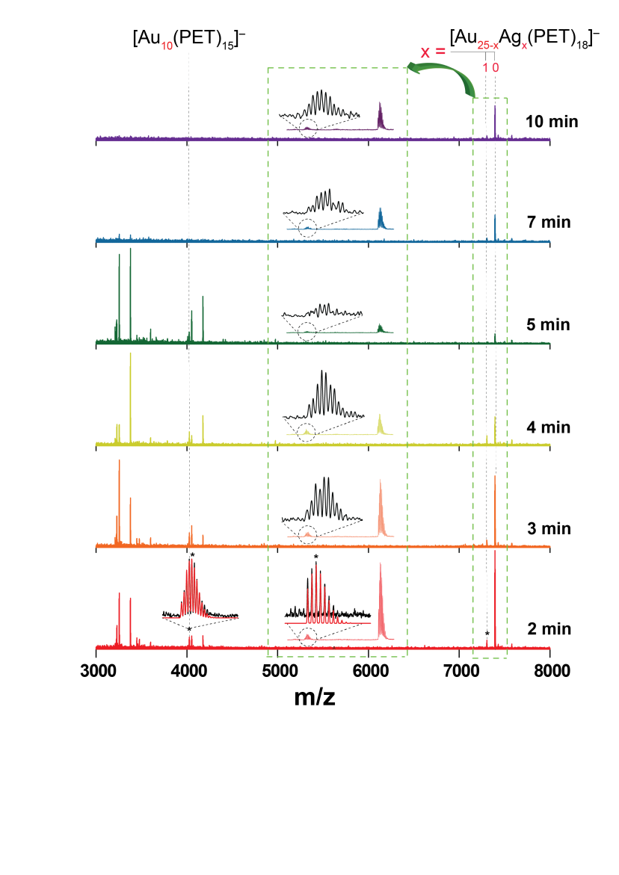

Slide 47
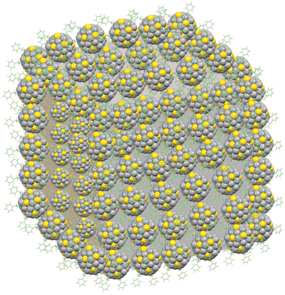
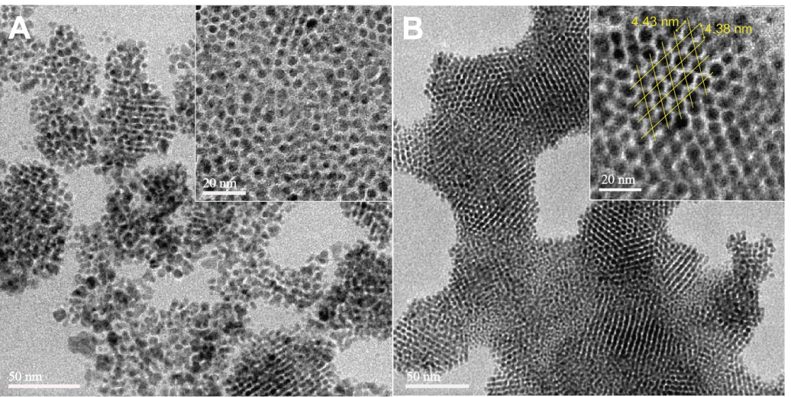
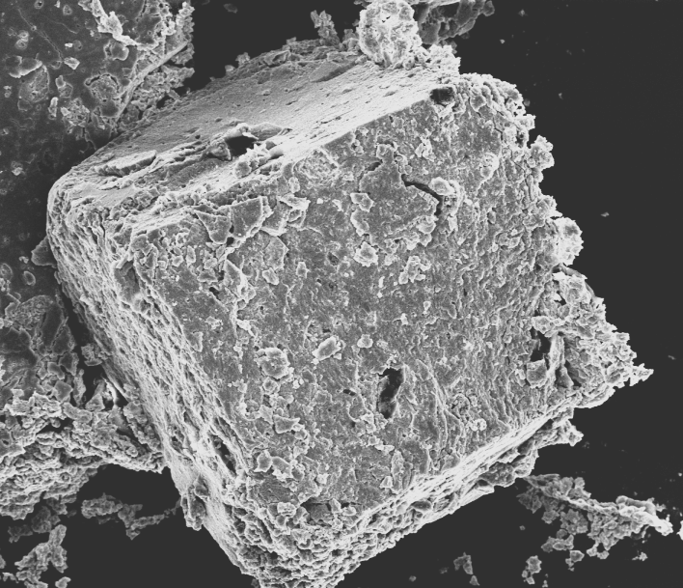
Crystallization of AgAu NP
A
B
C
Colloidal crystal
C
C

Slide 48
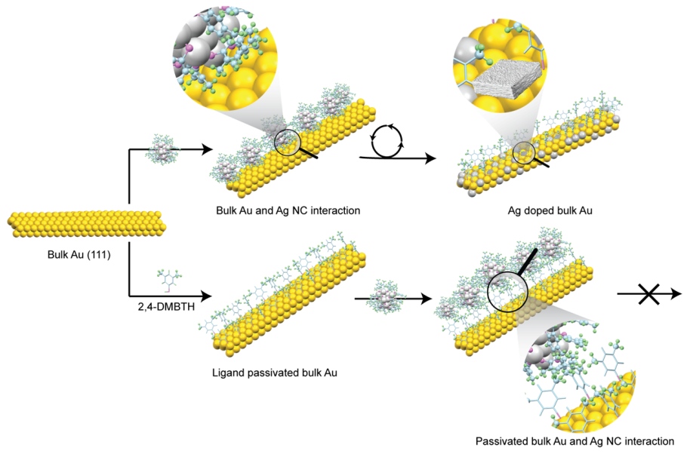
Bulk Au― Ag NC reaction

Slide 49
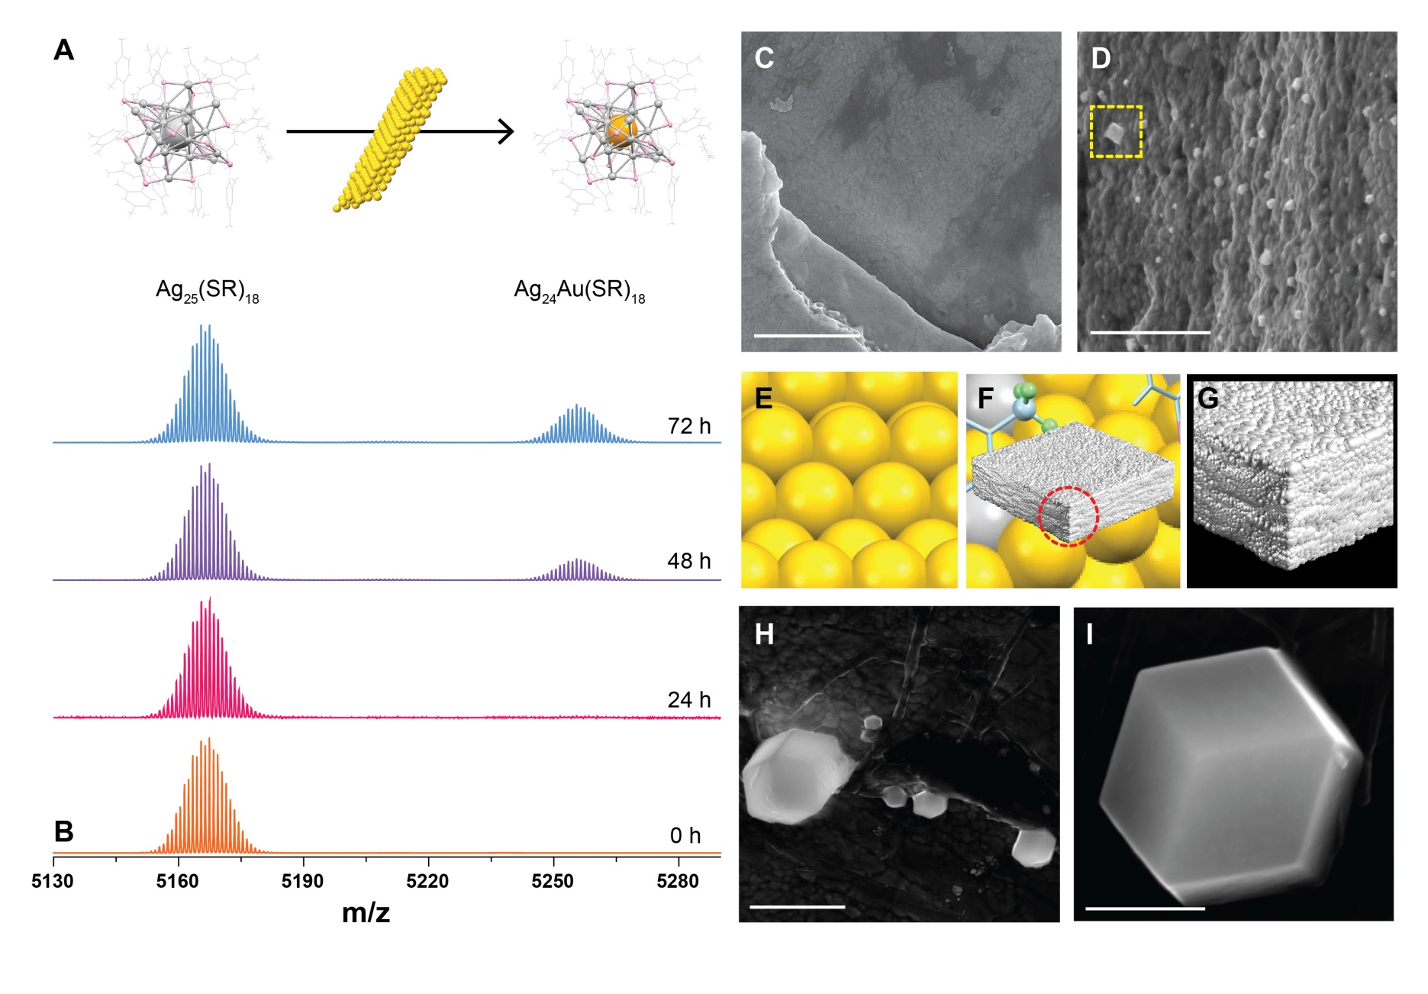
Characterization of reaction products

Slide 50
Expanding chemistry
Supramolecular chemistry
Papri Chakraborty, et,. al. ACS Nano 2018

Slide 51
Figure 1. A) (a) Full range ESI MS, (b) experimental and calculated isotope patterns and (c) DFT optimized structure of [Ag₂₉(BDT)₁₂]³⁻ cluster. B) (a) ESI MS of [Ag₂₉(BDT)₁₂(C₆₀)_{n}]³⁻ (n=1-4) complexes, (b) experimental and calculated isotope patterns of [Ag₂₉(BDT)₁₂(C₆₀)₄]³⁻ and (c) schematic of the possible structure of [Ag₂₉(BDT)₁₂(C₆₀)₄]³⁻.

Slide 52
Isomerism in supramolcular adducts
Abhijit Nag, et al. JACS 2018

Slide 53
A)
β-cyclodextrin = CD
Ag₂₉BDT₁₂ = X
X∩CD₁³⁻
Calculated
Experimental
X∩CD₂³⁻
a)
X∩CD₁³⁻
X∩CD₃³⁻
m/z
X³⁻
b)
X∩CD₄³⁻
CD⁻
X∩CD₅³⁻
X∩CD₆³⁻
X∩CD₁³⁻
m/z

Slide 54
X∩CD₃³⁻
X∩CD₆³⁻
a)
d)
Isomer 1
Isomer 2
613.0 Å²
628.0 Å²
903.0 Å²
X∩CD₂³⁻
X∩CD₅³⁻
b)
e)
Isomer 1
Isomer 2
526.0 Å²
812.0 Å²
540.0 Å²
X∩CD₁³⁻
X∩CD₄³⁻
c)
f)
Isomer 1
438.0 Å²
Isomer 2
705.0 Å²
724.0 Å²
Drift time (ms)
Drift time (ms)

Slide 55
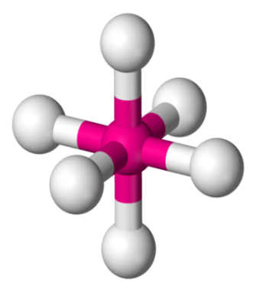
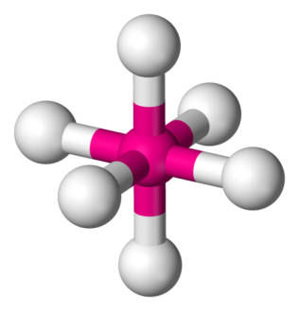
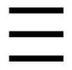
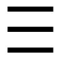





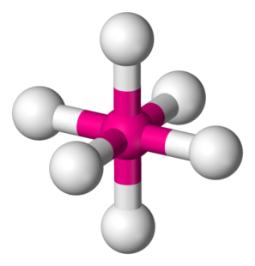
A)
a)
b)
c)
1
5/3
1
4
3/5
2
6
B)
b)
a)
i)
i)
ii)
1
1
1
3
2
2
6
Cis = C
Trans = T
C-Ag₂₉(BDT)₁₂∩CD₂
T-Ag₂₉(BDT)₁₂∩CD₂
C-Ag₂₉(BDT)₁₂∩CD₃
c)
ii)
i)
ii)
1
1
1
3
4
2
2
2
6
6
6
T-Ag₂₉(BDT)₁₂∩CD₃
C-Ag₂₉(BDT)₁₂∩CD₄
T-Ag₂₉(BDT)₁₂∩CD₄

Slide 56
Assemblies and superstructures

Slide 57
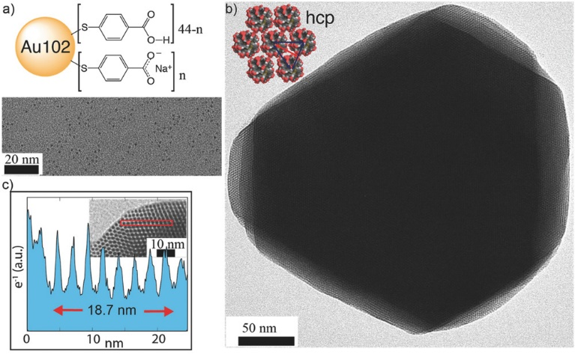
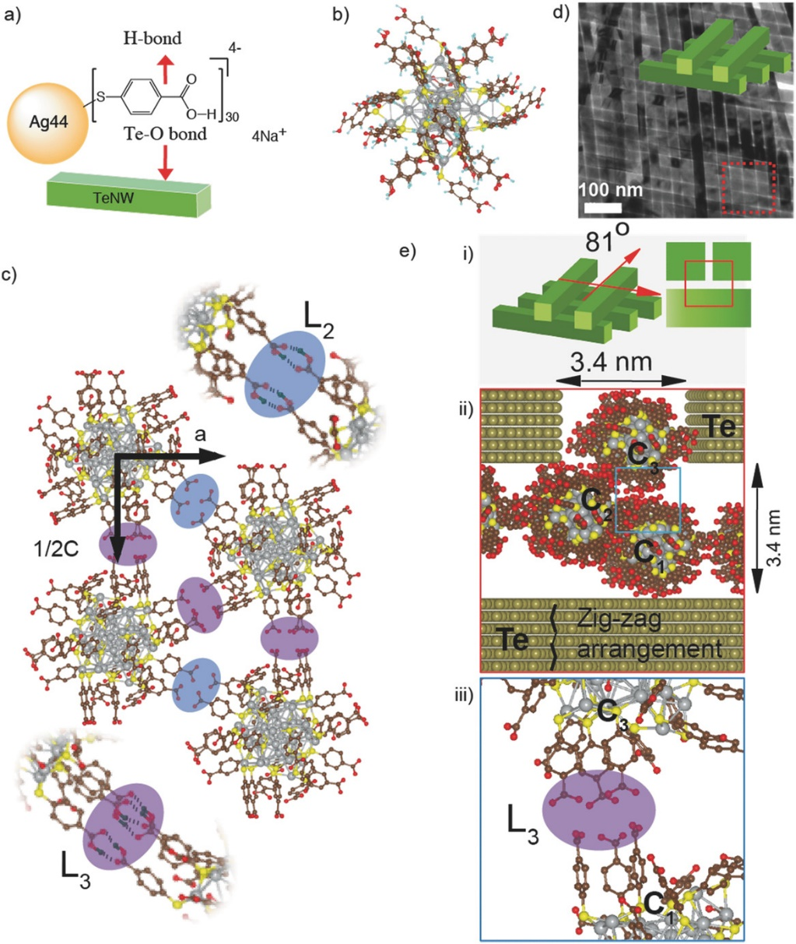
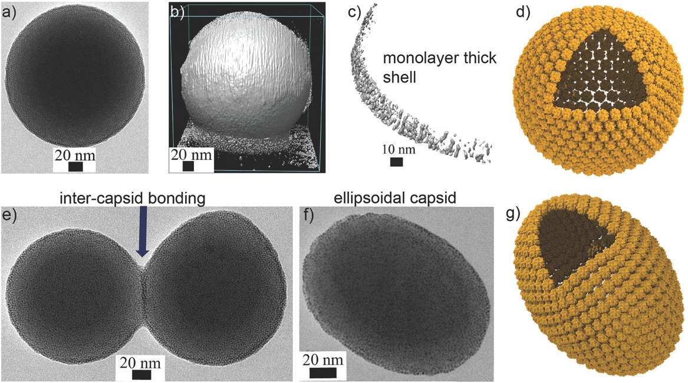
Nanoclusters in colloidal assemblies
Som, A. et al., Adv. Mater. 2016, 28, 2827–2833
Nonappa et al., Angew. Chem. Int. Ed. 2016, 55, 16035–16038.

Slide 58
Atomically precise nanocluster assemblies encapsulating plasmonic gold nanorods
Chakraborty, A. et al., Angew. Chem. Int. Ed. 2018, 57, 6522–6526.

Slide 59
Outlook
2019

Slide 60
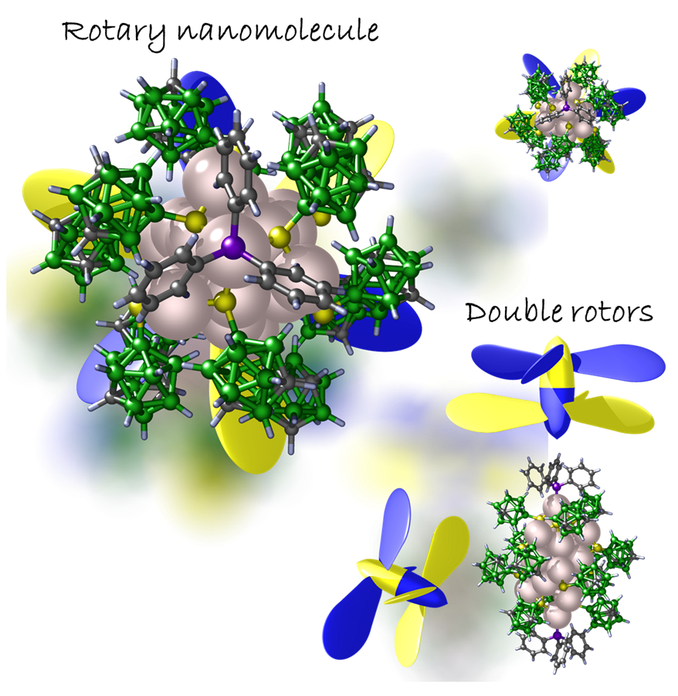
Carborane-thiol protected propeller-shaped photoresponsive silver nanomolecule
With Tomas Base
Jana et. al, Inorganic Chemistry (2022)

Slide 61
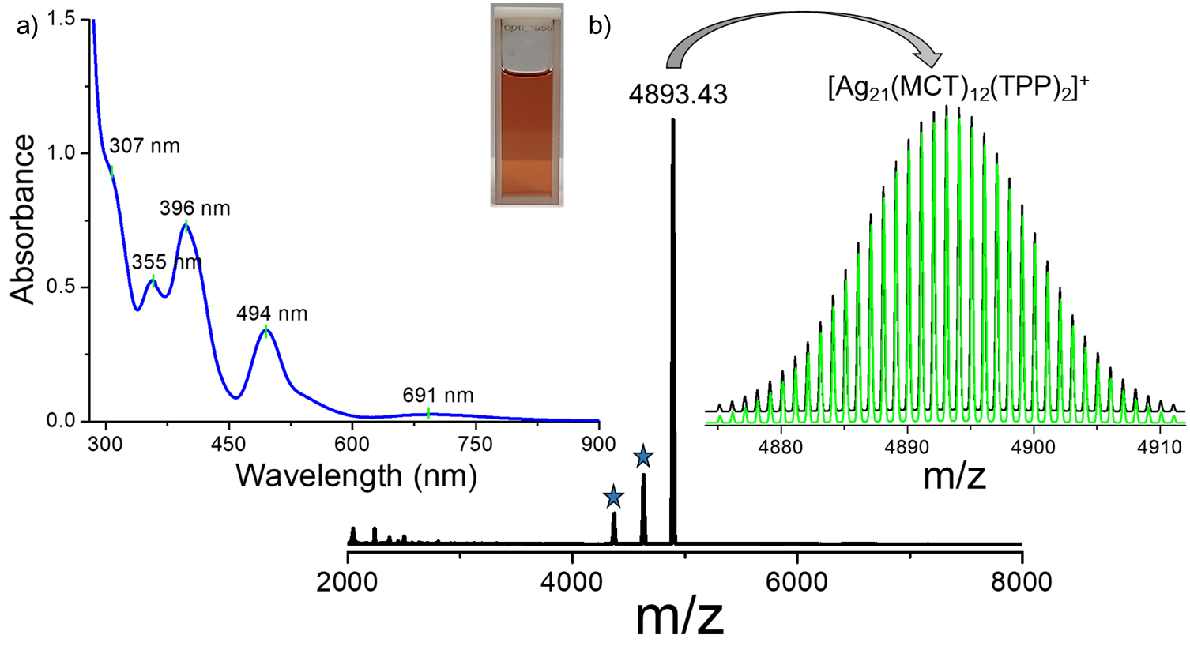
Characterization of Ag₂₁

Slide 62
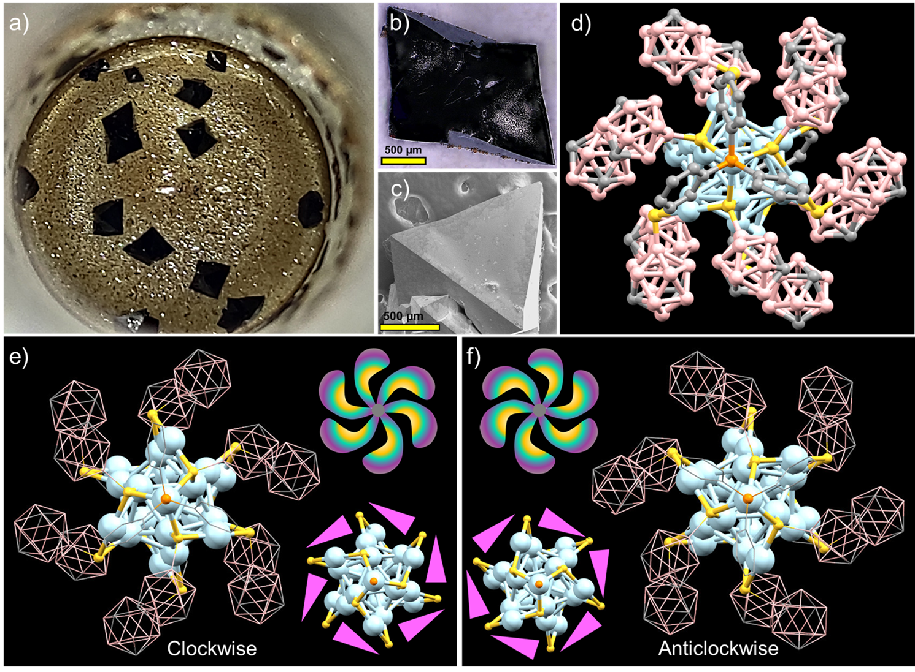
Structural details of Ag₂₁

Slide 63
Molecules and their properties
Molecular formula
Molecular weight
Molecular structure
Molecular absorption and emission
Molecular reactions
Molecular assembly
Molecular co-crystals
------
Phases - phase transitions
Physical properties
Electrical, magnetic
Mechanical properties
Electrochemical properties
Future?

Slide 64
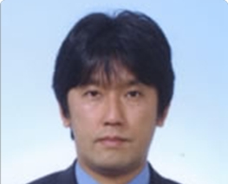
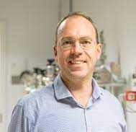

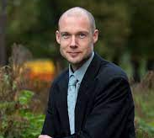
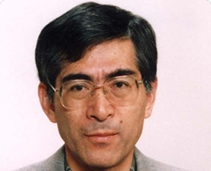
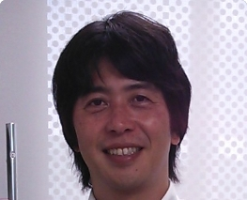

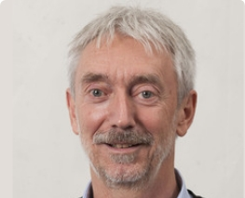
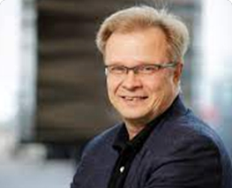




Collaborators
Robin Ras
Nonappa
Mauri Kostiainen
Horst Hahn
Olli Ikkala
Manfred Kappes
Tatsuya Tsukuda, Keisaku Kimura, Yuichi Negishi, Uzi Landman, Hannu Hakkinen, Rob Whetten, Tomas Base

Slide 65


Slide 66


Slide 67


Slide 68

Department of Science and Technology
Collaborators: Tatsuya Tsukuda, Keisaku Kimura, Yuichi Negishi, Uzi Landman, Rob Whetten, Hannu Hakkinen, Robin Ras, Manfred Kappes, Horst Hahn, Tomas Base, Shiv Khanna, Umesh Waghmare, Chandrabhas Narayana, Giridhar U. Kulkarni, Reji Philip, Vivek Polshettiwar, R. Mukhopadhay
Thank you all

