Slide 1






Since 1959
Complexity in the Chemistry of Atomically Precise Clusters
T. Pradeep
Institute Professor, IIT Madras
https://pradeepresearch.org/
pradeep@iitm.ac.in
Co-founder
InnoNano Research Pvt. Ltd.
InnoDI Water Technologies Pvt. Ltd.
VayuJAL Technologies Pvt. Ltd.
Aqueasy Innovations Pvt. Ltd.
Hydromaterials Pvt. Ltd.
EyeNetAqua Pvt. Ltd.
Deepspectrum Analytics Pvt. Ltd.
Jeong-Woo Choi
Chairperson of AsiaNANO 2022
And colleagues
Professor-in-charge
Associate Editor
International Centre for Clean Water
AsiaNANO 2022 Asian Conference on Nanoscience & Nanotechnology, Busan, November 9-11, 2022

Slide 2
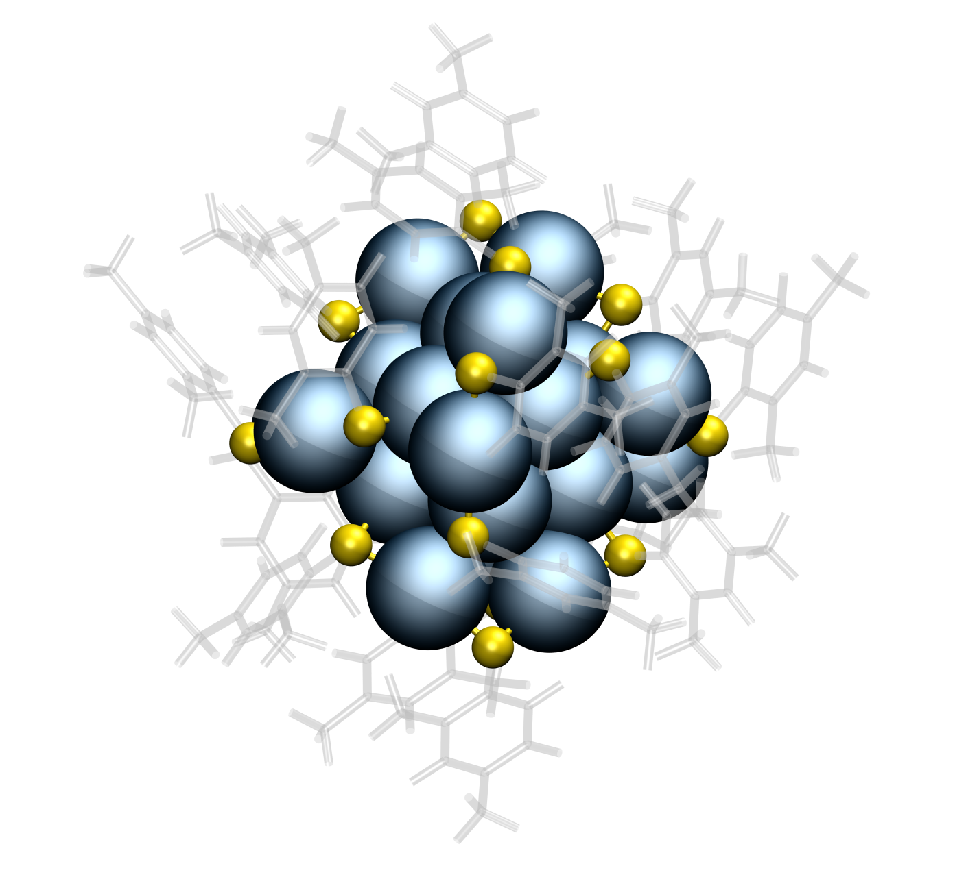
Au₂₅, Ag₂₅, Ag₂₉

Slide 3
Citations: >1200
Also the pioneering work of R. W. Murray, Robert L. Whetten, Uzi Landman, Tatuya Tsukuda, Yuichi Negishi, Hannu Hakkinen,
Rongchao Jin, Nanfeng Zheng, Terry Bigioni, Osman Bakr, Kornberg, Jianping Xie, C. M. Aikens, Thomas Buergi, Amala Dass, Ackerson, De-en Jiang, …. A. W. Castleman Jr., H. Schmidbauer, …. Robin Ras, Olli Ikkala
…Manfred Kappes, Horst Hahn

Slide 4
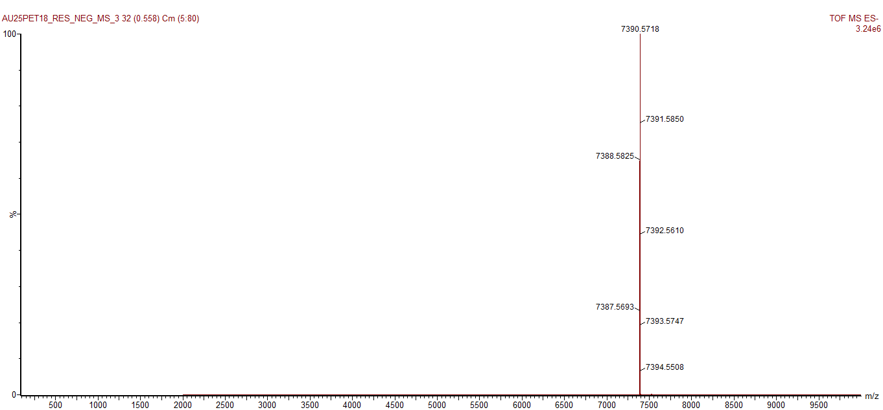
Molecular formula, Molecular weight
Au₂₅L₁₈⁻
Au₃₈SR₂₄
Au₁₀₂SR₄₄

Slide 5
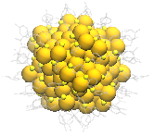
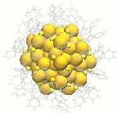
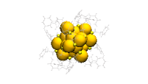
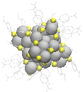
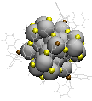
Ag₂₉(BDT)₁₂³⁻
Ag₂₅(DMBT)₁₈⁻
Au₂₅(PET)₁₈⁻
HRMS of Au₂₅(PET)₁₈⁻
m/z

Slide 6
They make high quality crystals

Slide 7
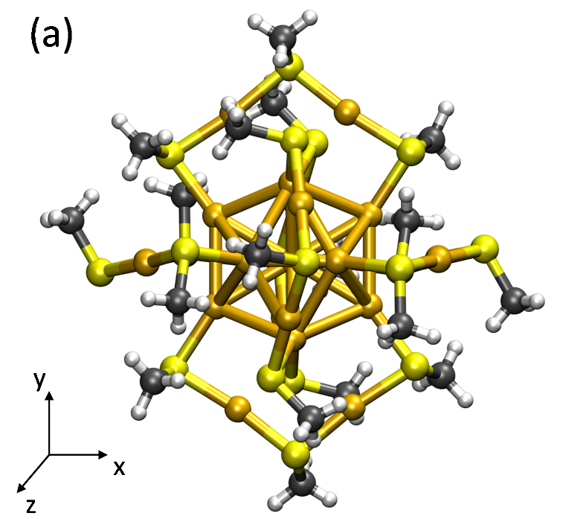
Molecular structure
Geometric and electronic shells
Gana Natarajan

Slide 8
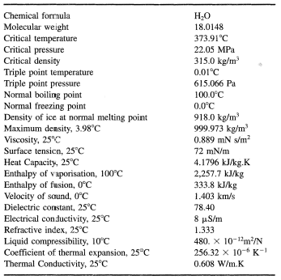
Molecules and their properties

Slide 9
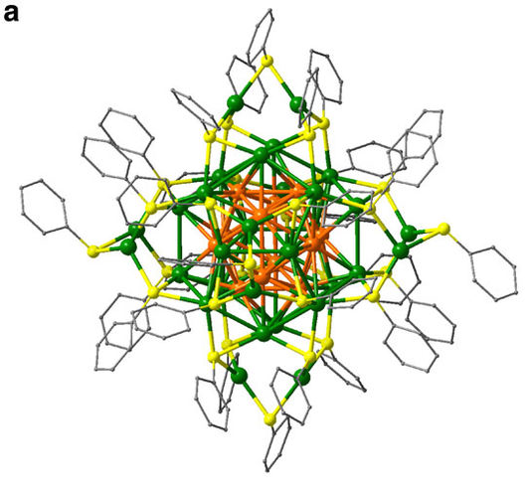
Ag₄₄
Nanfeng Zheng et al. Nature Communications, 2013
Terry Bigioni et al. Nature 2013

Slide 10
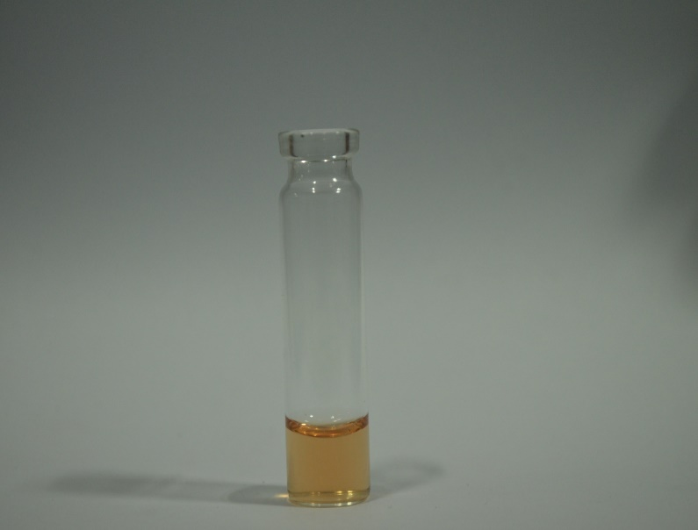
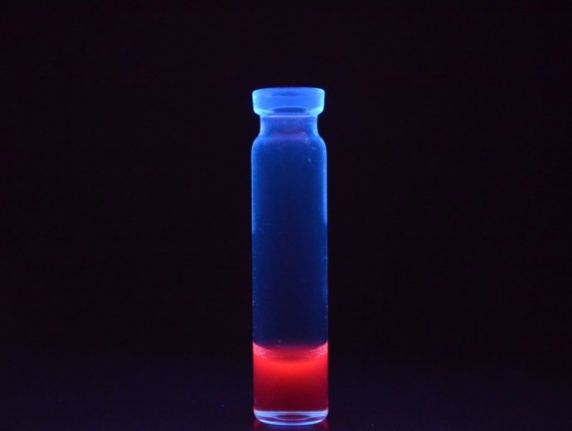
Molecular reactions
Reactions on clusters
Reactions between clusters

Slide 11
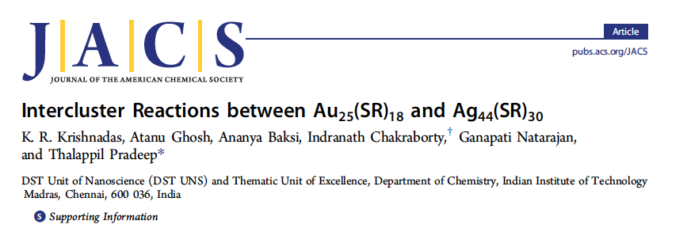
Inter-cluster reactions
A + B → C + D

Slide 12
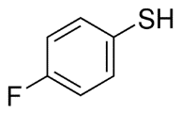
Au₂₅(FTP)₁₈ + Ag₄₄(FTP)₃₀ Au_{25-x}Ag_{x}(FTP)₁₈

Slide 14
Energies for the substitution reaction of (A) Au in Ag₄₄(SR)₃₀, (B) Ag in Au₂₅(SR)₁₈ and (C) the overall reaction energies (in eV) as a function of their positions in product clusters, Au_{x}Ag_{44-x}(SR)₃₀ and Au_{25-x}Ag_{x}(SR)₁₈ for x=1

Slide 15
Ag₂₅-Au₂₅ experiments
K. R. Krishnadas et al. Nature Commun. 2016

Slide 16
Reaction between Au₂₅(PET)₁₈ and Ag₂₅(DMBT)₁₈
DMBT
PET

Slide 17
[Ag₂₅(DMBT)₁₈+Au₂₅(PET)₁₈]²⁻
DMBT
PET
Ag₂₅(DMBT)₁₈
[Ag₂₅(DMBT)₁₈+Au₂₅(PET)₁₈]²⁻
Au₂₅(PET)₁₈

Slide 18
Evolution of alloy clusters from the dianionic adduct,
[Ag₂₅Au₂₅(DMBT)₁₈(PET)₁₈]²⁻
within 5 min
Ag₂₅(DMBT)₁₈:Au₂₅(PET)₁₈
0.3:1.0
within 2 min

Slide 19
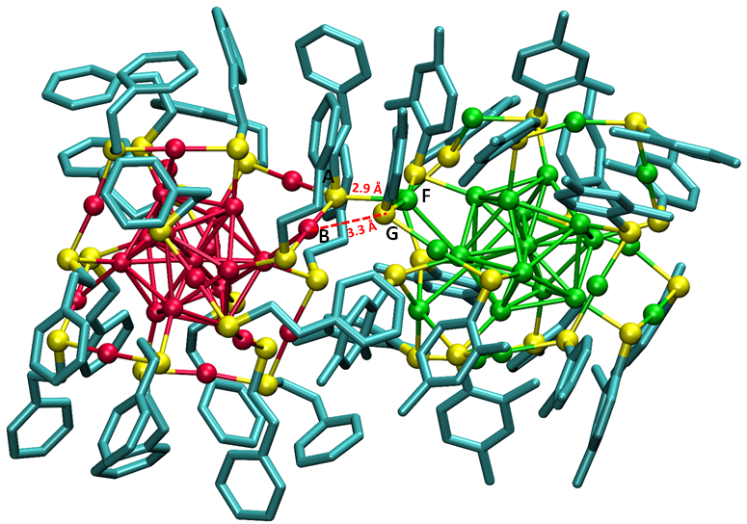
Optimized structure of [Ag₂₅Au₂₅(DMBT)₁₈(PET)₁₈]²⁻

Slide 21
How do we comprehend this?

Slide 23
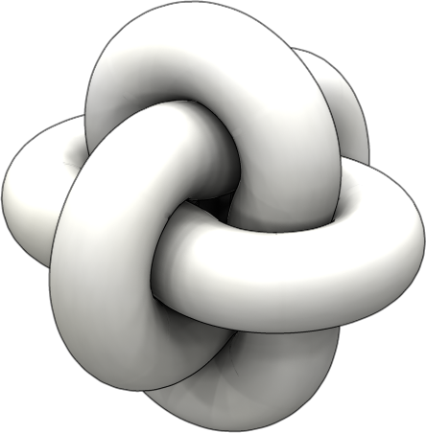
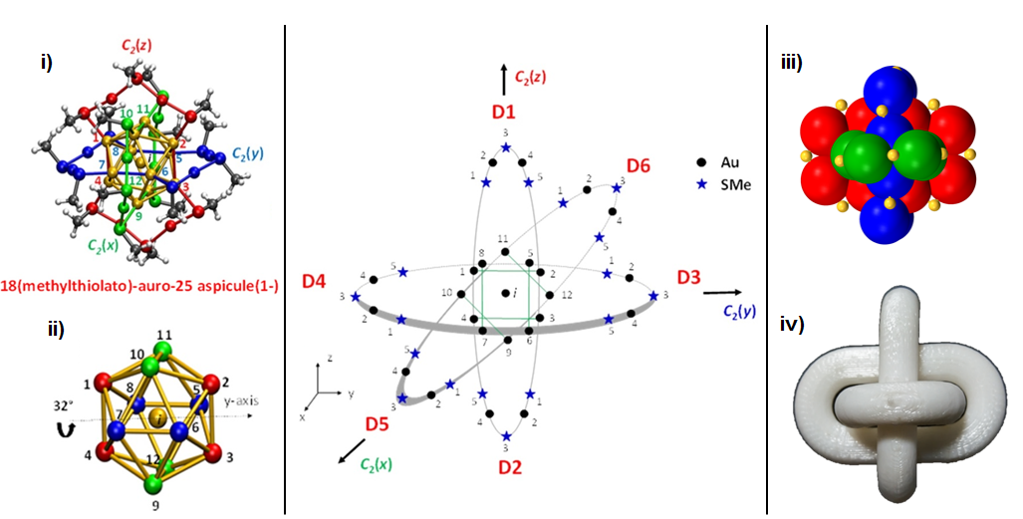
Gana Natarajan et. al. JPC C 2015

Slide 24
Aspicules

Slide 25
(D1-3,D2-3)-di(2-phenylethylthiolato),16(methylthiolato)-auro-25 aspicule(1-)
(D1-3,D2-3)-(PET)₂,(SMe)₁₆-auro-25 aspicule(1-)

Slide 26
3
y
Ligand Exchange & Alloy cluster
Au
2
4
z´
Au₂₄Pd(SR₁)₁₀(SR₂)₈ isomer 1 (cis)
1, 5-(SBB)₁₀, 3-(SC₆H₁₂)₈
(i, 1, 2, x2)-palladoauro-25 asp (-1)
1
5
S
2
3
1
4
11
5
4
1
5
1
4
5
6
2
x
x´
10
i
12
3
3
2
8
7
4
1
5
5
3
2
9
y
4
1
1
x
z
3
2
5
z
4
2
y´
3

Slide 27
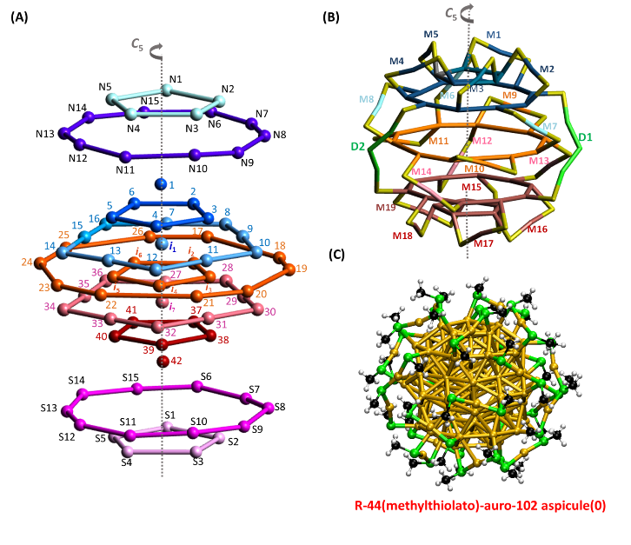
R-(SMe)₄₄-auro-102 aspicule(0) and L-(SMe)₄₄-auro-102 aspicule(0)

Slide 29
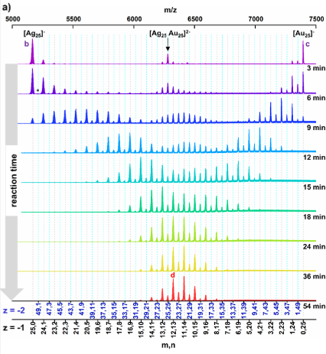
Manfred Kappes, KIT
M. Neumaier, A. Baksi, et. al., JACS 2021

Slide 30
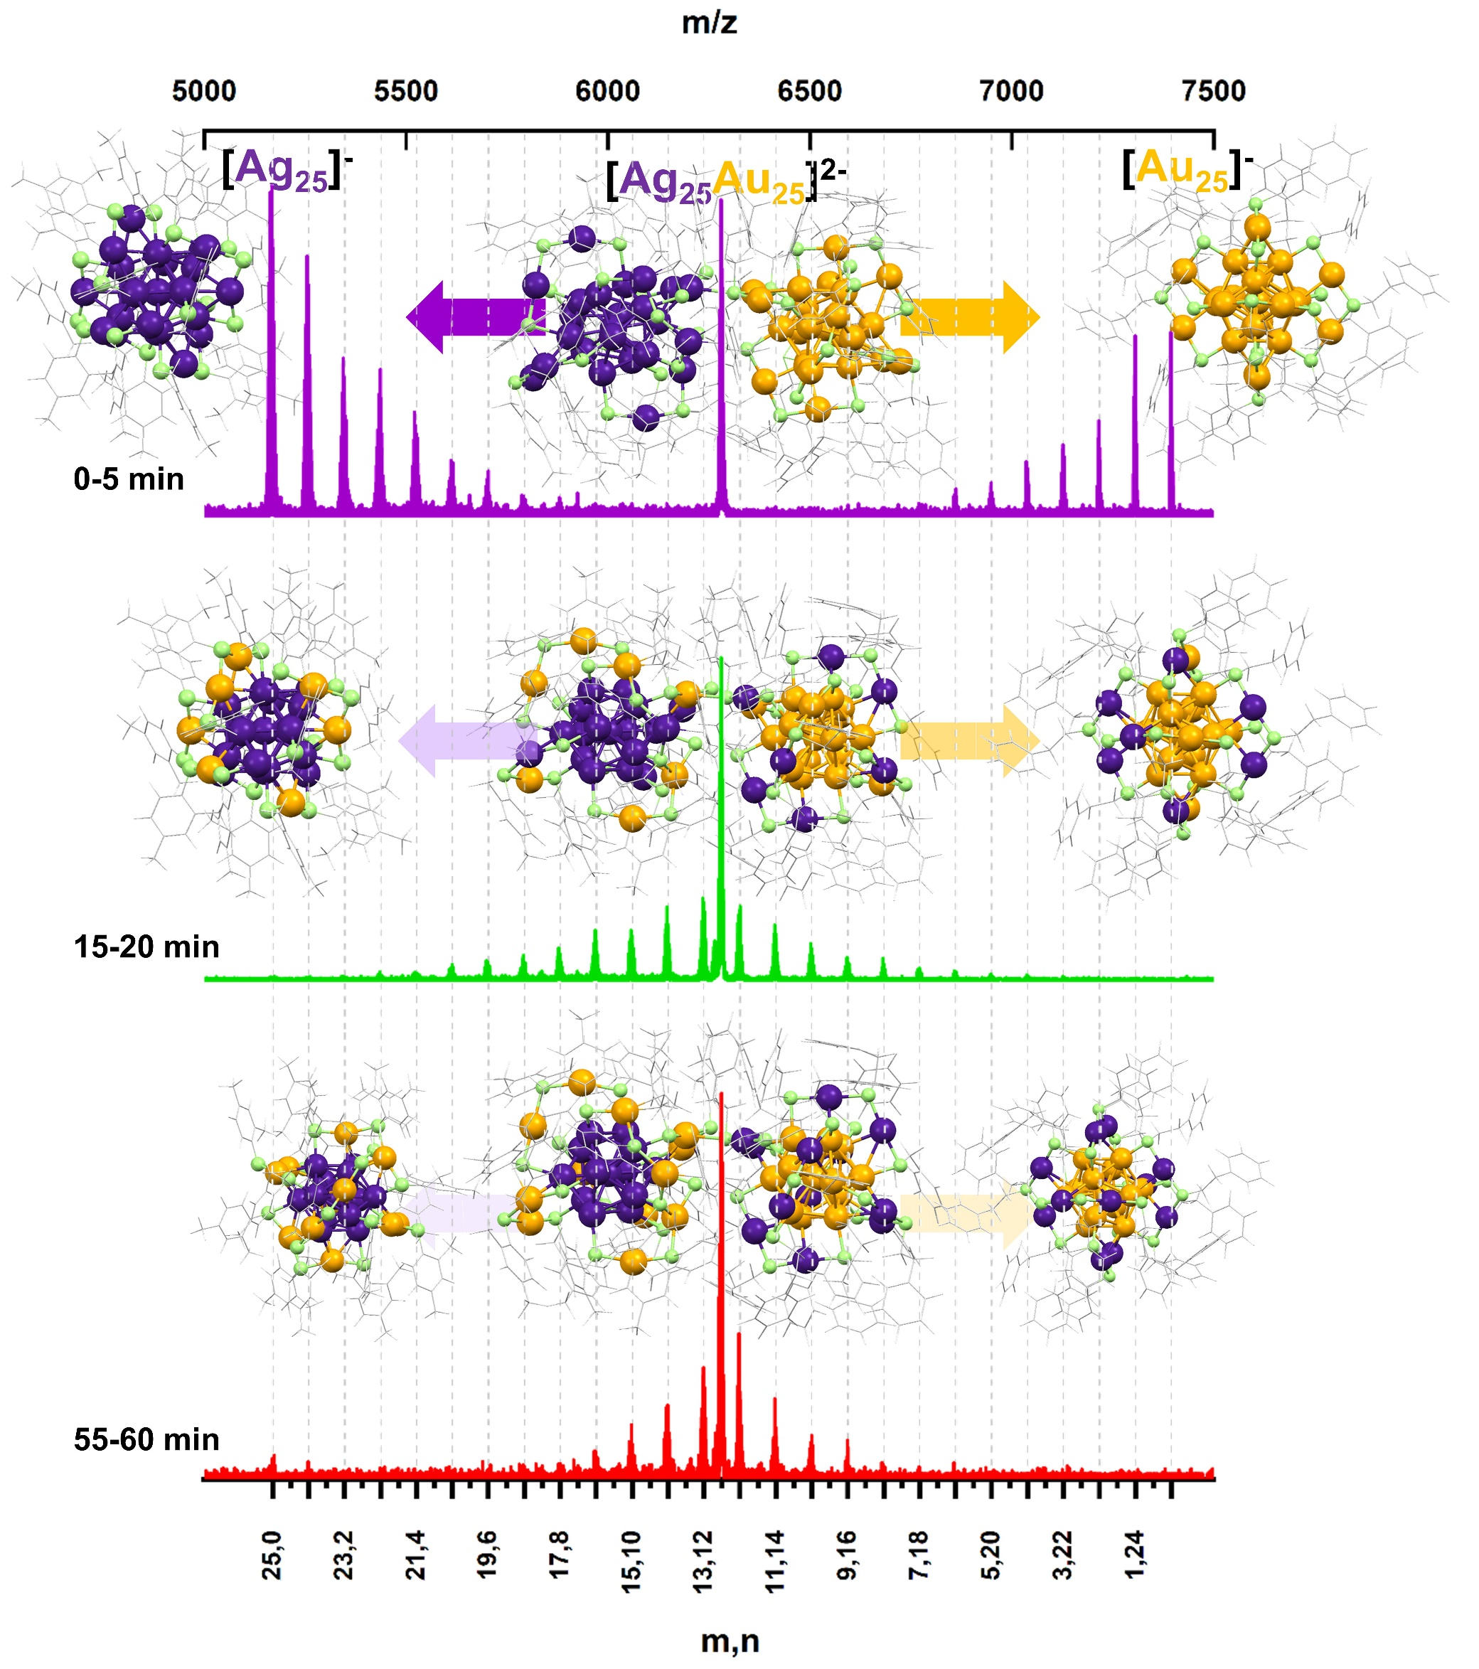
CID data of [Au25Ag25]²⁻

Slide 31
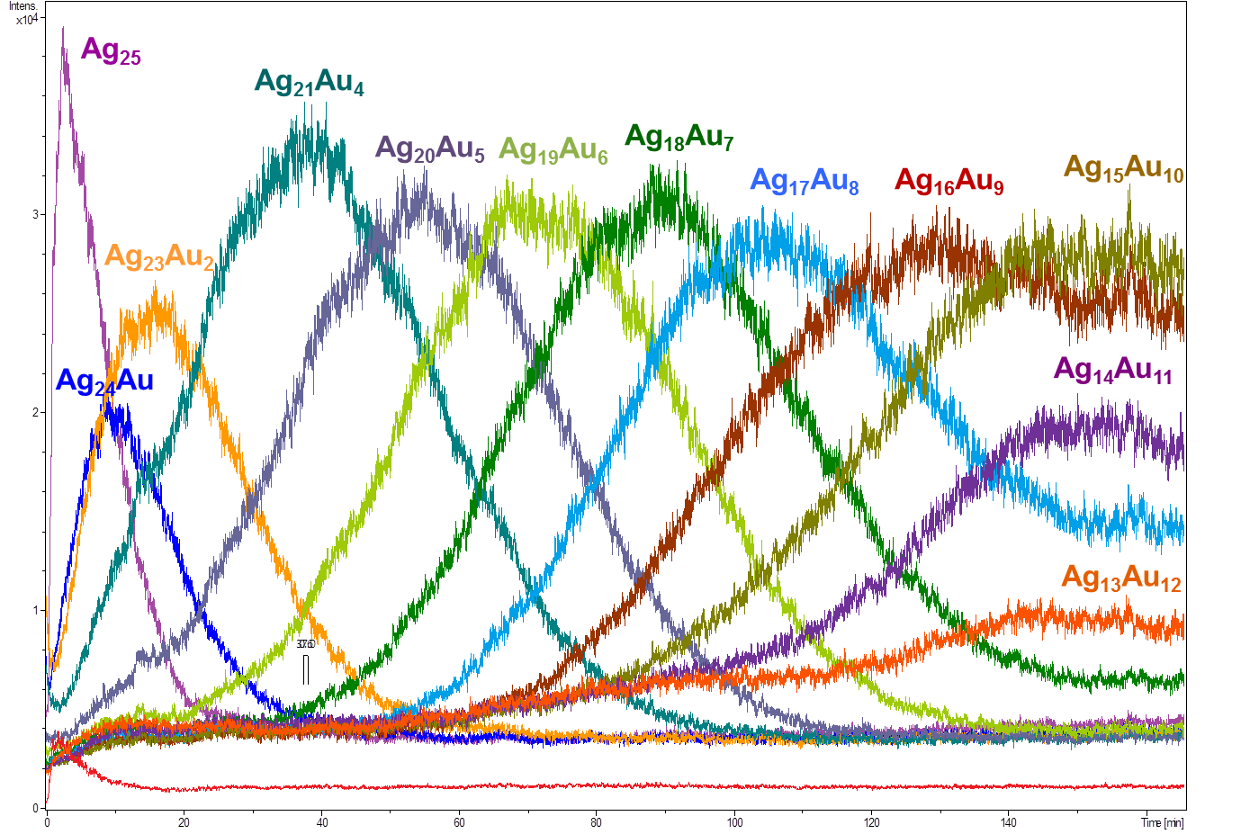
Kinetics of the exchange (monitored on the Ag₂₅ side)

Slide 32
Expanding reactions

Slide 34
Interparticle reactions forming product co-crystals

Slide 35
Co-crystals
Ag₄₀ and Ag₄₆ with the same shell
M. Bodiuzzaman, et. al. Angew. Chem. Int. Ed. 2018

Slide 36
Atom transfer dynamics
They are indeed molecules!

Slide 38
ESI MS of A) ¹⁰⁷Ag₂₅(DMBT)₁₈ and B)¹⁰⁹Ag₂₅(DMBT)₁₈. Insets shows the respective isotope patterns.

Slide 39
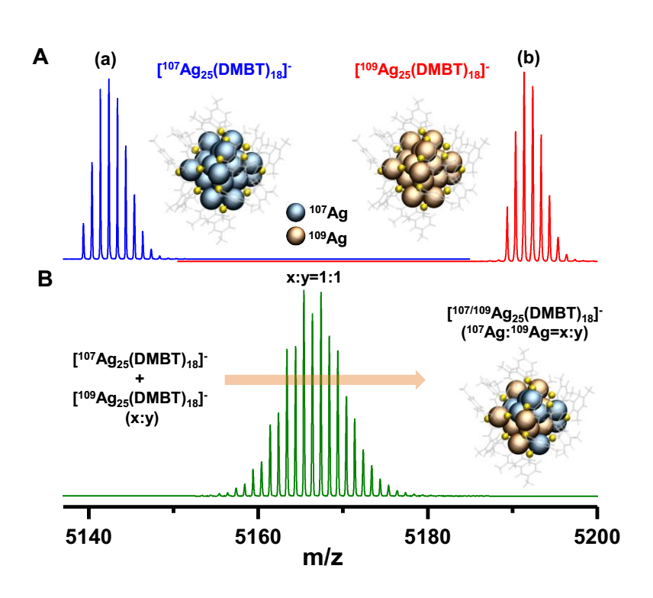

Slide 40
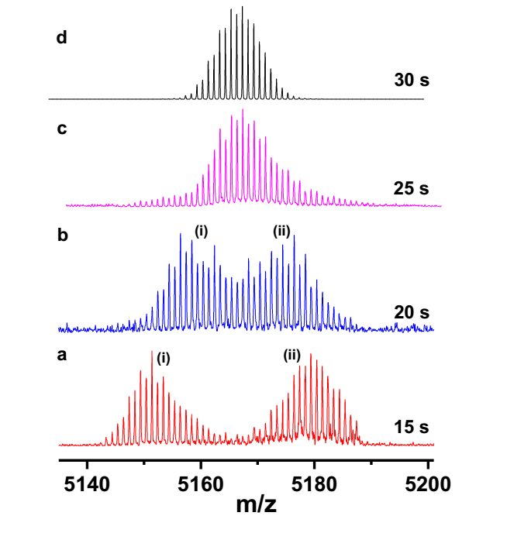
Papri Chakraborty, et. al. Science Advances 2019

Slide 41
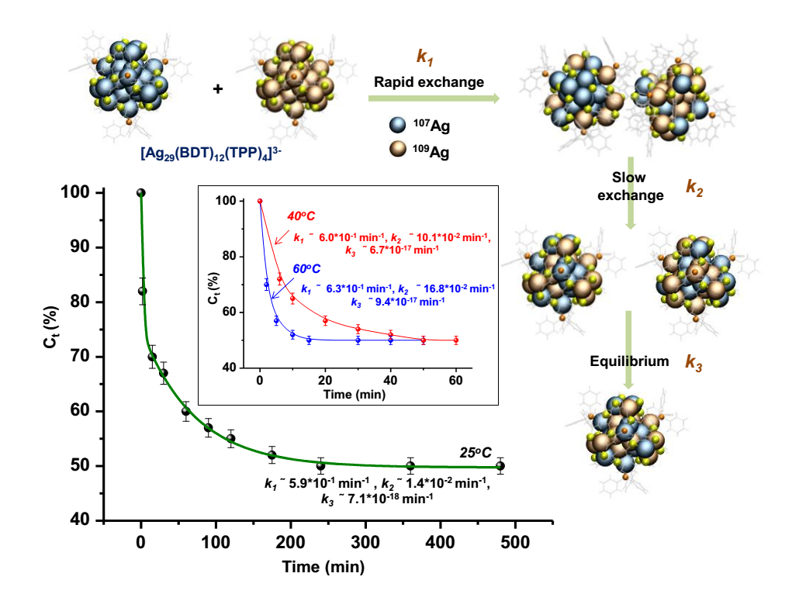

Slide 42
Can clusters react with nanoparticles?

Slide 43
Paulami Bose et al. Nanoscale 2020

Slide 44
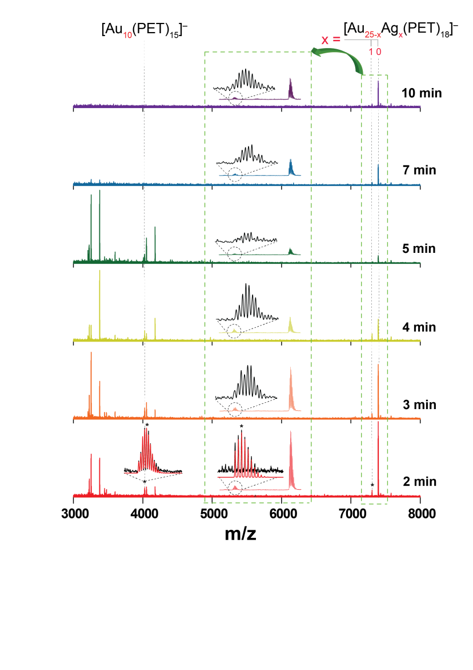

Slide 45
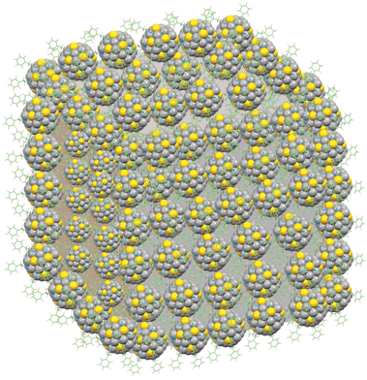
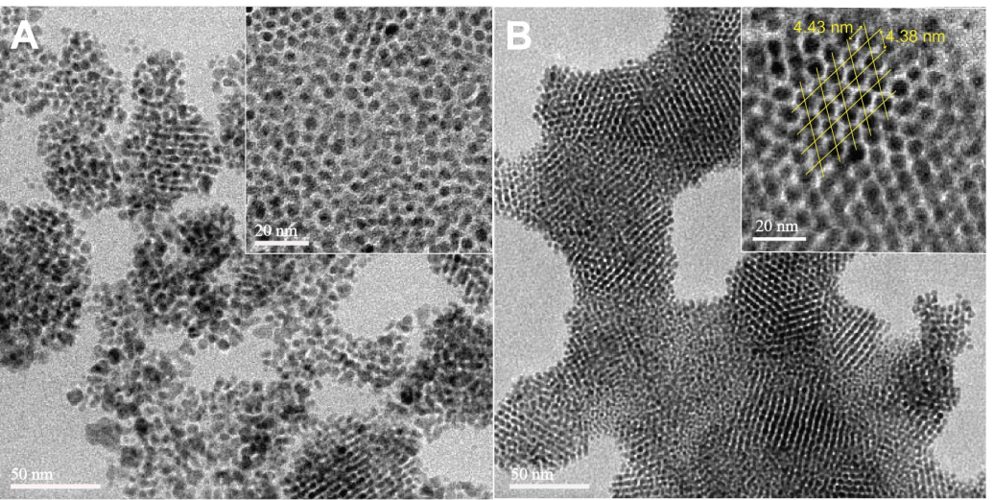
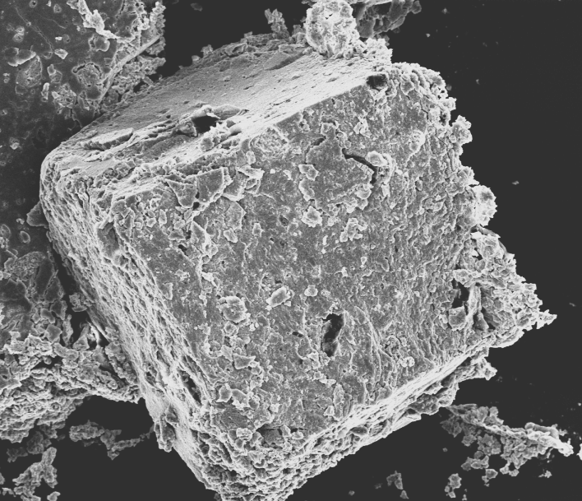
Crystallization of AgAu NP
A
B
C
Colloidal crystal
C
C

Slide 46
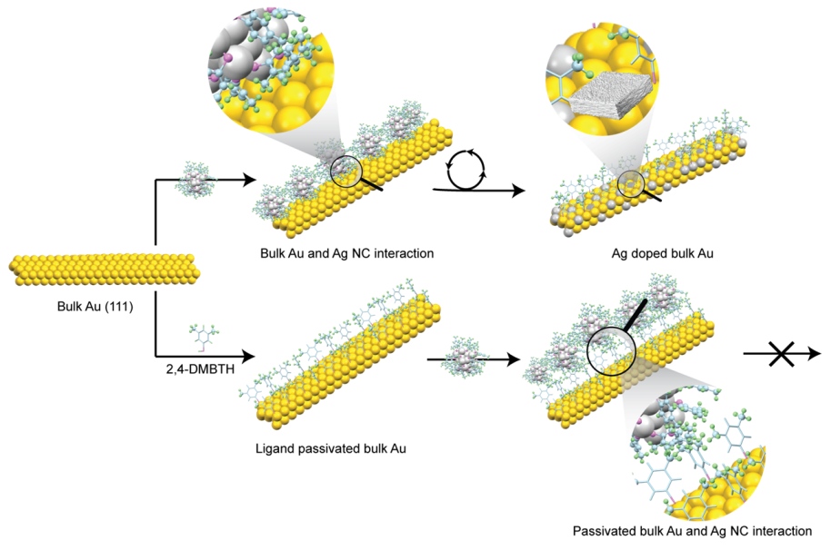
Bulk Au― Ag NC reaction

Slide 47
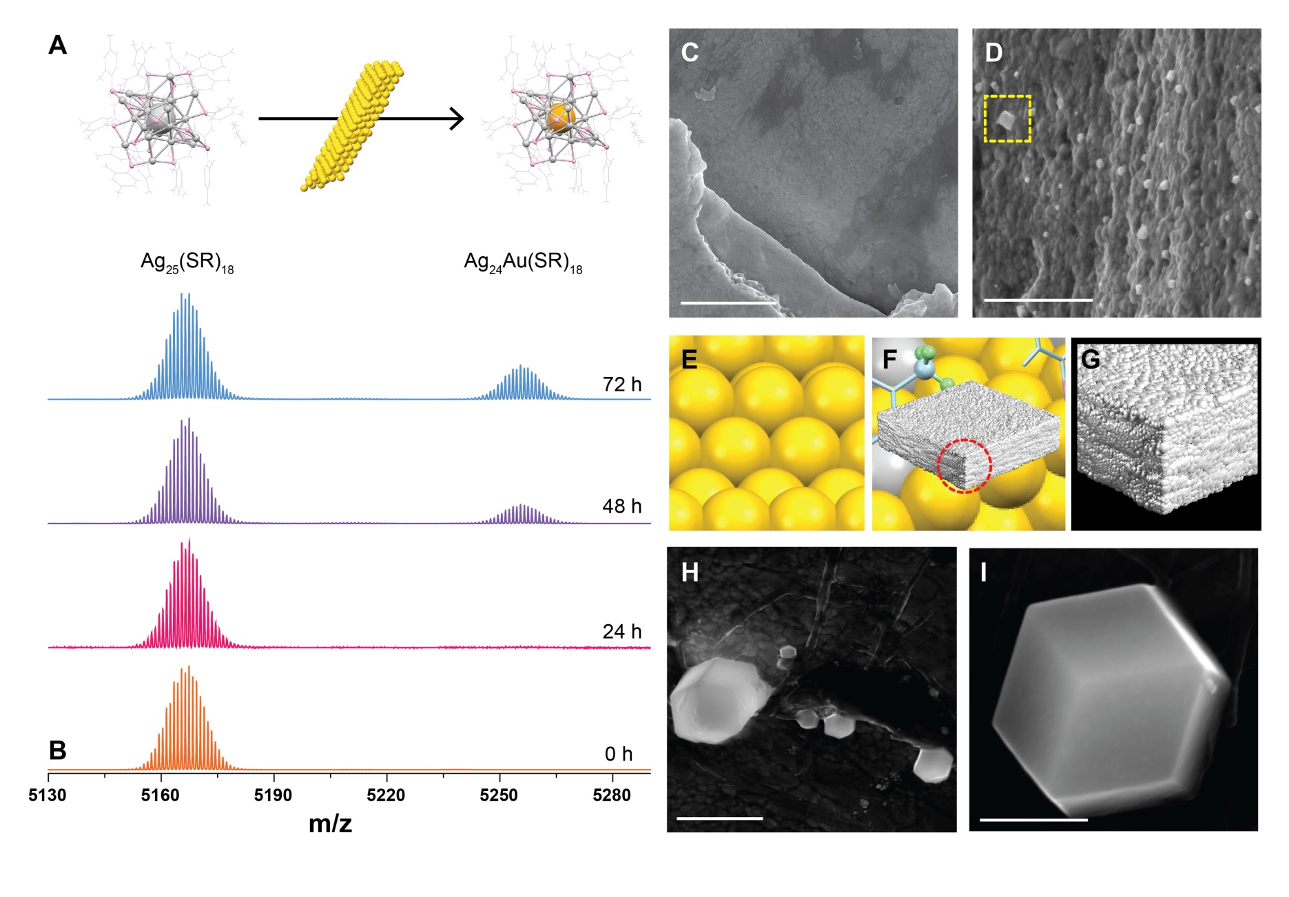
Characterization of reaction products

Slide 48
Expanding chemistry
Supramolecular chemistry
Papri Chakraborty, et,. al. ACS Nano 2018

Slide 49
Figure 1. A) (a) Full range ESI MS, (b) experimental and calculated isotope patterns and (c) DFT optimized structure of [Ag₂₉(BDT)₁₂]³⁻ cluster. B) (a) ESI MS of [Ag₂₉(BDT)₁₂(C₆₀)_{n}]³⁻ (n=1-4) complexes, (b) experimental and calculated isotope patterns of [Ag₂₉(BDT)₁₂(C₆₀)₄]³⁻ and (c) schematic of the possible structure of [Ag₂₉(BDT)₁₂(C₆₀)₄]³⁻.

Slide 50
Isomerism in supramolcular adducts
Abhijit Nag, et al. JACS 2018

Slide 51
A)
β-cyclodextrin = CD
Ag₂₉BDT₁₂ = X
X∩CD₁³⁻
Calculated
Experimental
X∩CD₂³⁻
a)
X∩CD₁³⁻
X∩CD₃³⁻
m/z
X³⁻
b)
X∩CD₄³⁻
CD⁻
X∩CD₅³⁻
X∩CD₆³⁻
X∩CD₁³⁻
m/z

Slide 52
X∩CD₃³⁻
X∩CD₆³⁻
a)
d)
Isomer 1
Isomer 2
613.0 Å²
628.0 Å²
903.0 Å²
X∩CD₂³⁻
X∩CD₅³⁻
b)
e)
Isomer 1
Isomer 2
526.0 Å²
812.0 Å²
540.0 Å²
X∩CD₁³⁻
X∩CD₄³⁻
c)
f)
Isomer 1
438.0 Å²
Isomer 2
705.0 Å²
724.0 Å²
Drift time (ms)
Drift time (ms)

Slide 53
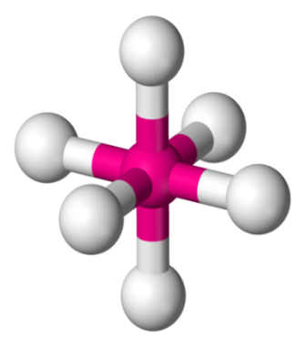
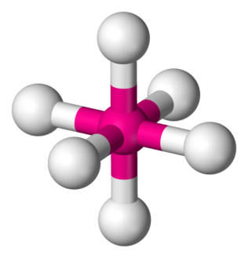
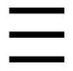
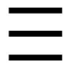





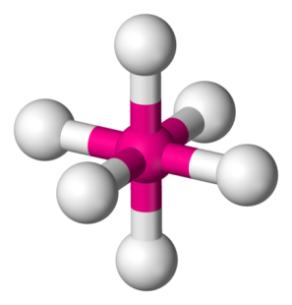
A)
a)
b)
c)
1
5/3
1
4
3/5
2
6
B)
b)
a)
i)
i)
ii)
1
1
1
3
2
2
6
Cis = C
Trans = T
C-Ag₂₉(BDT)₁₂∩CD₂
T-Ag₂₉(BDT)₁₂∩CD₂
C-Ag₂₉(BDT)₁₂∩CD₃
c)
ii)
i)
ii)
1
1
1
3
4
2
2
2
6
6
6
T-Ag₂₉(BDT)₁₂∩CD₃
C-Ag₂₉(BDT)₁₂∩CD₄
T-Ag₂₉(BDT)₁₂∩CD₄

Slide 54
Assemblies and superstructures

Slide 55
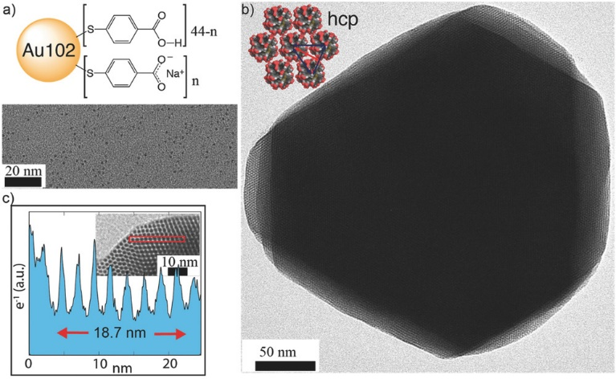
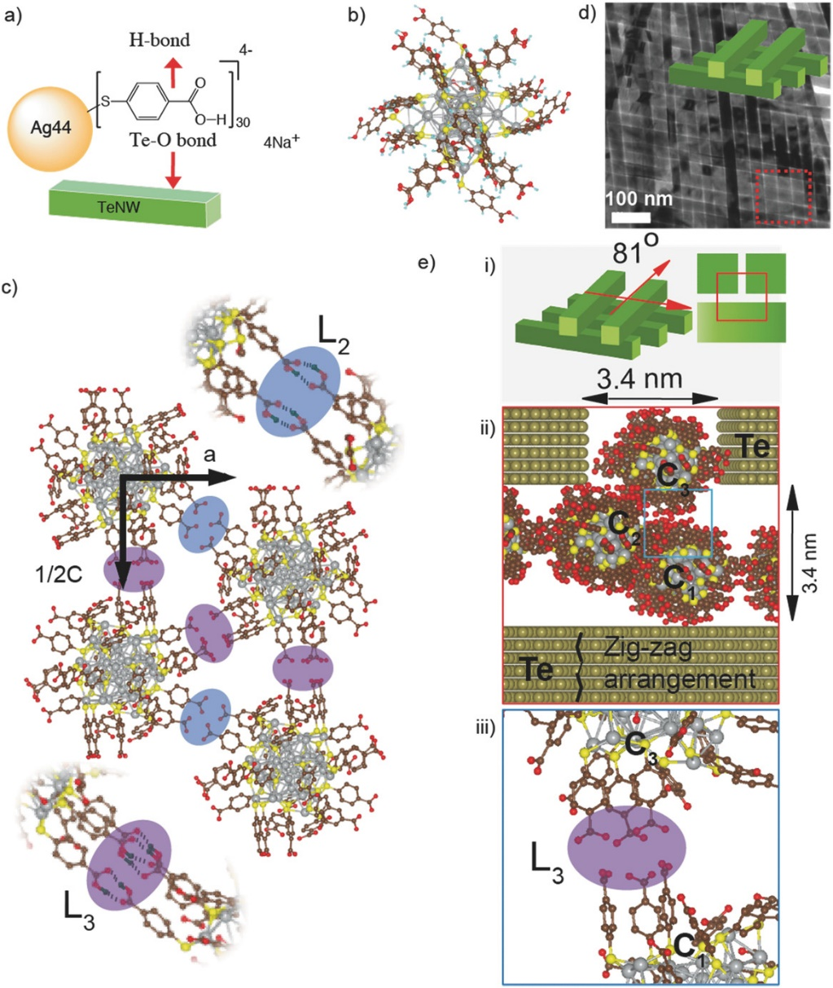
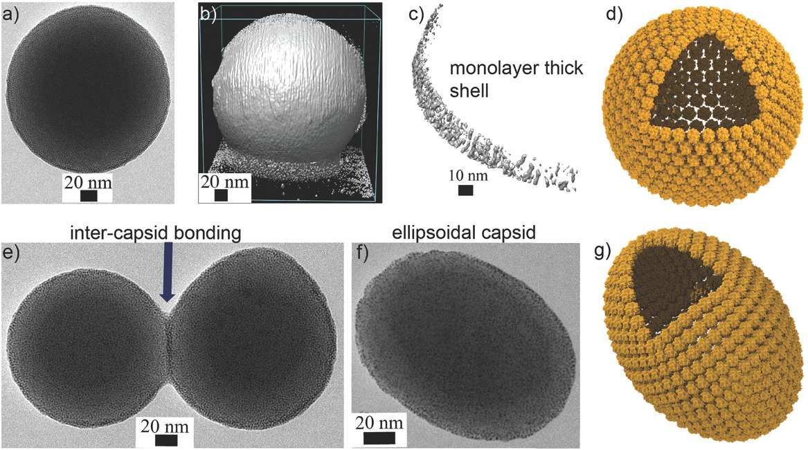
Nanoclusters in colloidal assemblies
Som, A. et al., Adv. Mater. 2016, 28, 2827–2833
Nonappa et al., Angew. Chem. Int. Ed. 2016, 55, 16035–16038.

Slide 56
Atomically precise nanocluster assemblies encapsulating plasmonic gold nanorods
Chakraborty, A. et al., Angew. Chem. Int. Ed. 2018, 57, 6522–6526.

Slide 57
Outlook
2019

Slide 58
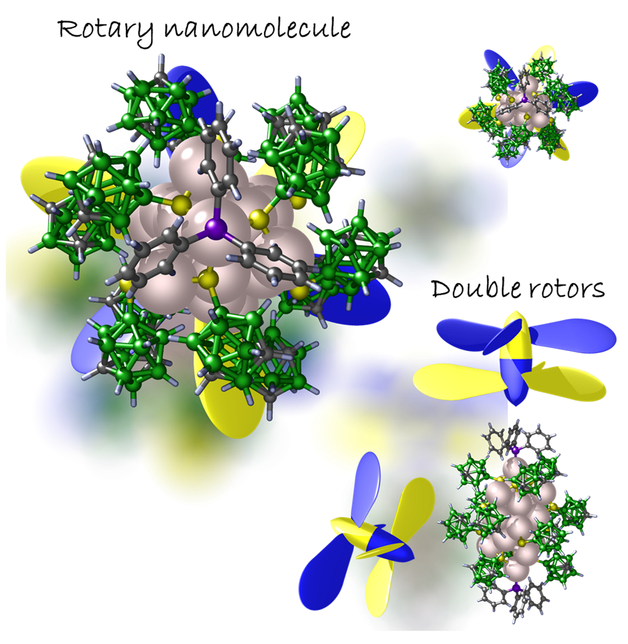
Carborane-thiol protected propeller-shaped photoresponsive silver nanomolecule
With Tomas Base
Jana et. al, Inorganic Chemistry (2022)

Slide 59
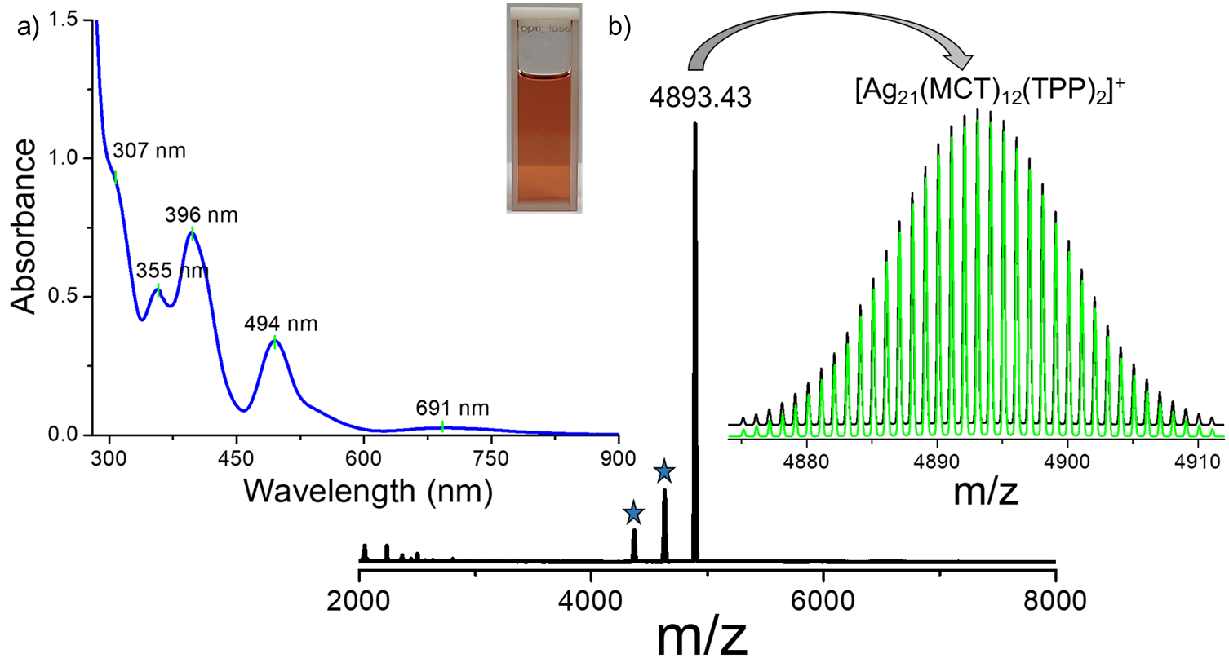
Characterization of Ag₂₁

Slide 60
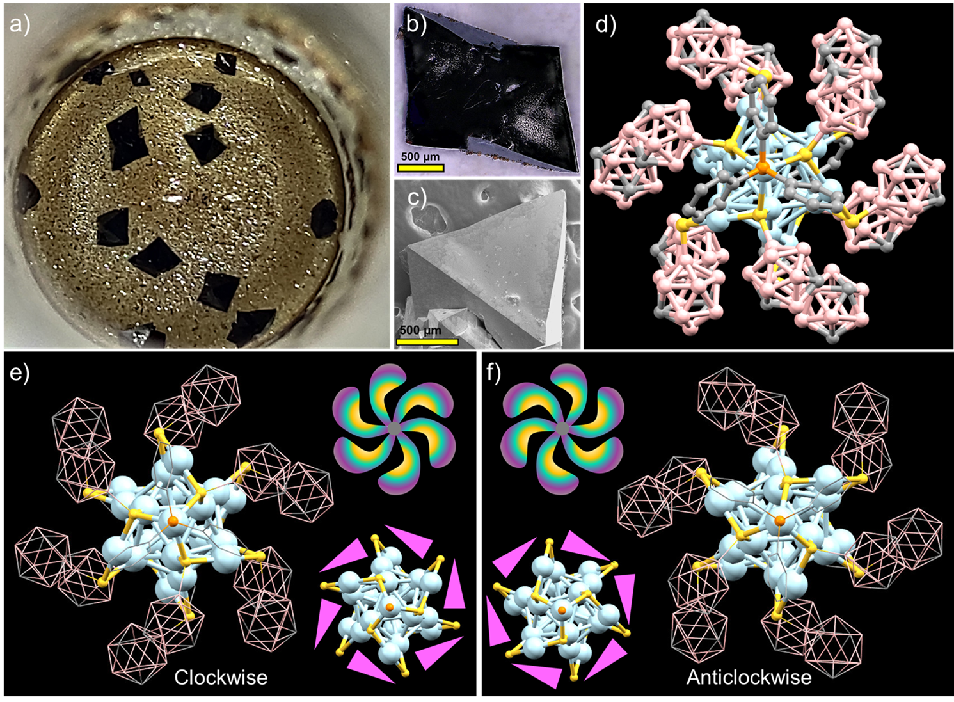
Structural details of Ag₂₁

Slide 61
Molecules and their properties
Molecular formula
Molecular weight
Molecular structure
Molecular absorption and emission
Molecular reactions
Molecular assembly
Molecular co-crystals
------
Phases - phase transitions
Physical properties
Electrical, magnetic
Mechanical properties
Electrochemical properties
Future?

Slide 62
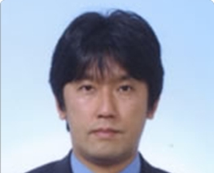
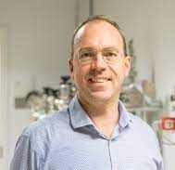

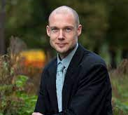
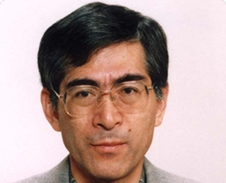
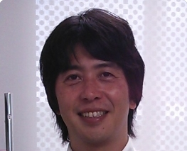


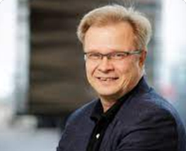
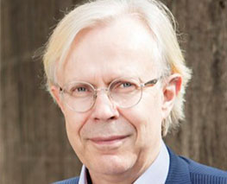
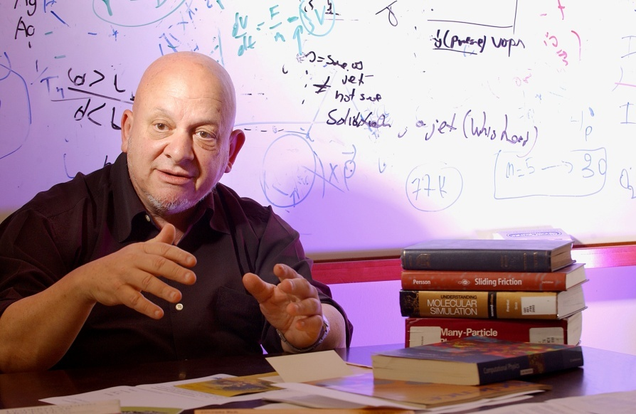
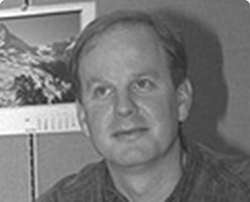

Collaborators
Robin Ras
Nonappa
Mauri Kostiainen
Horst Hahn
Olli Ikkala
Manfred Kappes
Tatsuya Tsukuda, Keisaku Kimura, Yuichi Negishi, Uzi Landman, Hannu Hakkinen, Rob Whetten, Tomas Base

Slide 63


Slide 64


Slide 65


Slide 66

Department of Science and Technology
Collaborators: Tatsuya Tsukuda, Keisaku Kimura, Yuichi Negishi, Uzi Landman, Rob Whetten, Hannu Hakkinen, Robin Ras, Manfred Kappes, Horst Hahn, Tomas Base, Shiv Khanna, Umesh Waghmare, Chandrabhas Narayana, Giridhar U. Kulkarni, Reji Philip, Vivek Polshettiwar, R. Mukhopadhay
Thank you all

